Slide 1
MOLECULAR DYNAMICS: Bcl-xL w/ BIM BH3 domain
Dana Seibert
Vistas in Advanced Computing 2017

Slide 2
Bcl-xL w/ BIM BH3 domain
Bcl-2 Family in charge of homeostasis during apoptosis
B cell leukemia/lymphoma 2
Homeostasis-
Apoptosis- Programmed cell death due to age or damage
One structure: Bcl-X_{L}
Contains BH3 peptide complex
Particularly BIM peptide
Studied crystal structure of human Bcl-X_{L} in complex with BID^{BH3} and BIM^{BH3}
Visualize Bcl-X_{L} in complex with BIM^{BH3}
Notes:
B cell leukemia/lymphoma 2- family of proteins, apoptotic regulators, mediate mitochrondrial outer membrane permeabilization (point of no return), do this by creating disruptions in the membrane thus releasing death-promoting proteins like cytochrome C, Anti-apoptotic proteins (prevent it), like most proteins: have inhibition and activation sites, balance between anti and pro is very important, prevents cancer
Other BH3 peptides: BAD, BAK, BAX, PUMA, SOUL, Beclin, and other BH3 mutants/variants

Slide 3
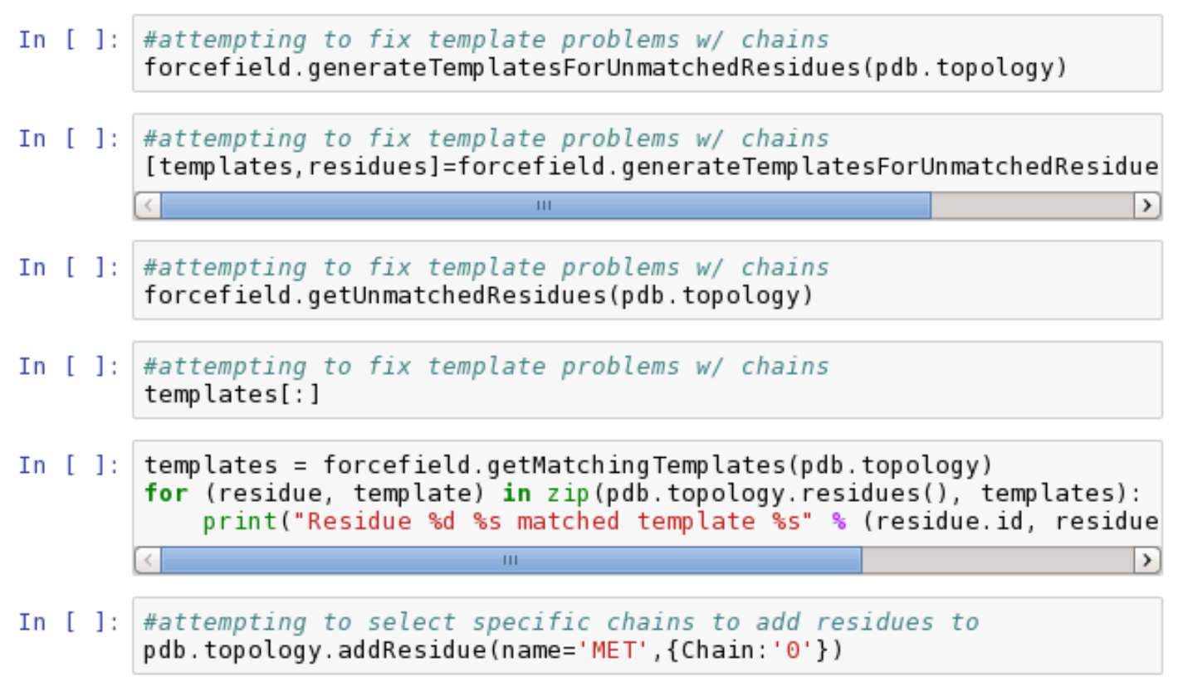
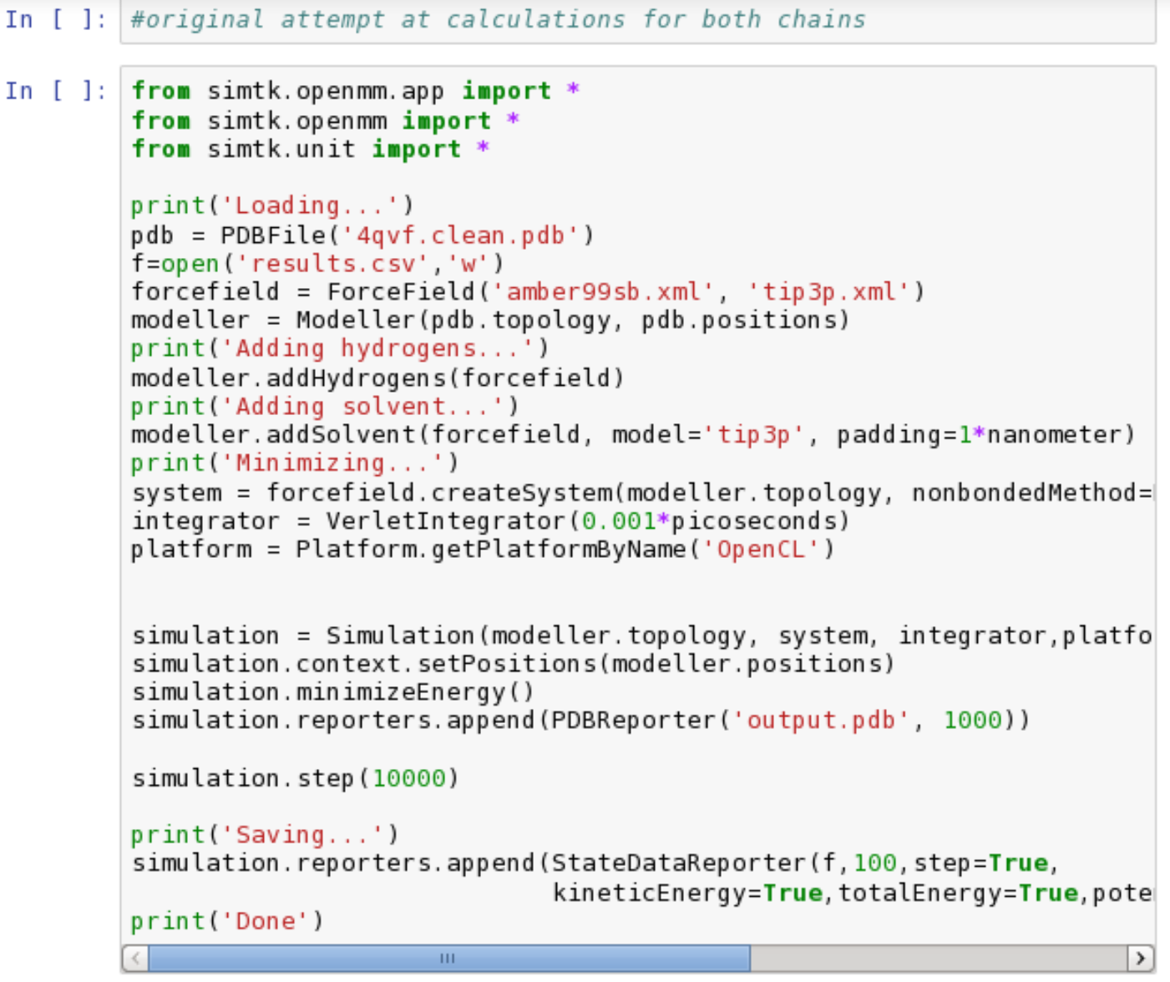
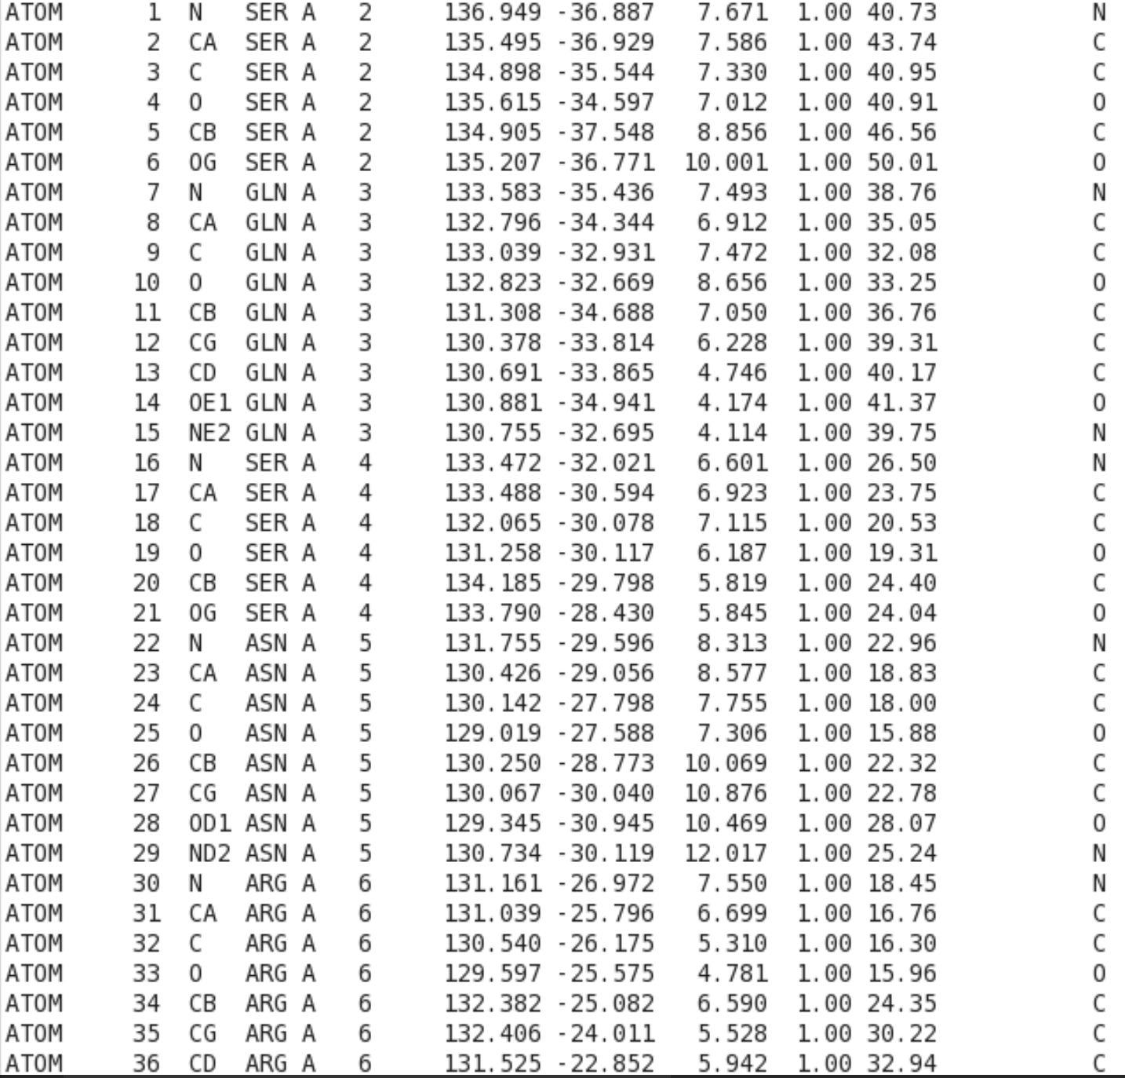
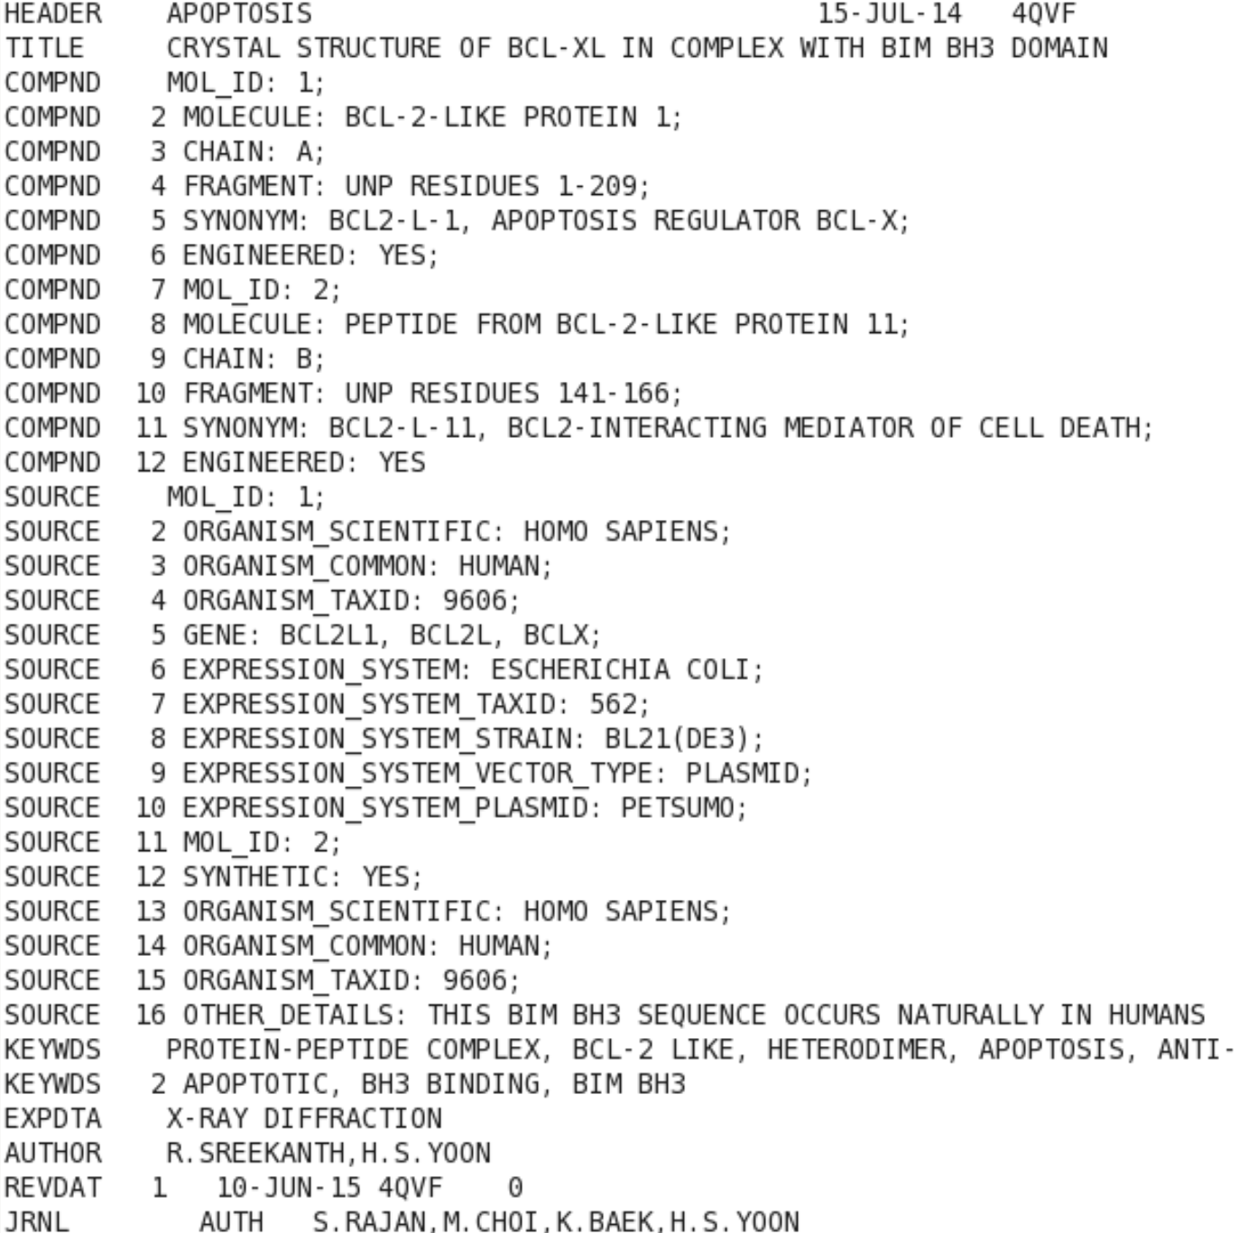
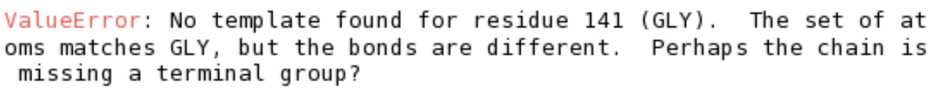
4QVF
Find PDB file from RCSB
Use MobaXterm and server
Clean file
grep “^ATOM” 4qvf.pdb > 4qvf.clean.pdb
Using example code, attempted editing molecule
Didn’t work
Notes:
MobaXterm- similar to PuTTy, but allows for multiple sessions to run at once
Used it for jupyter notebooks and python compiling and running

Slide 4
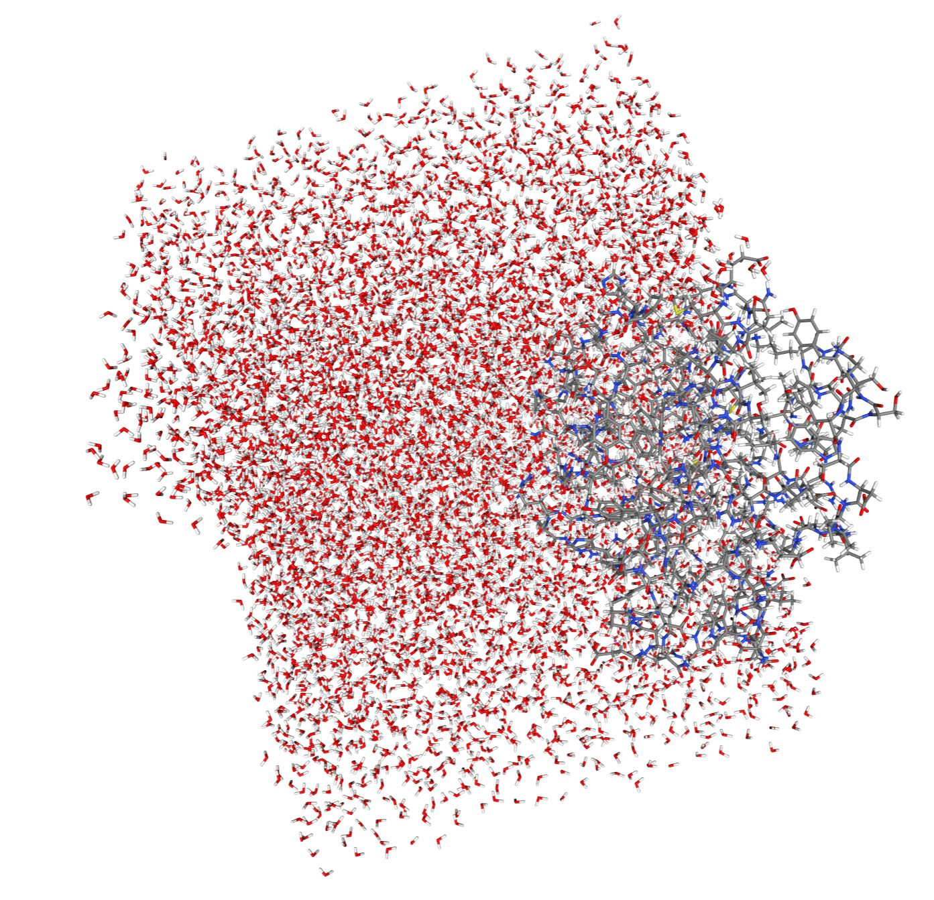
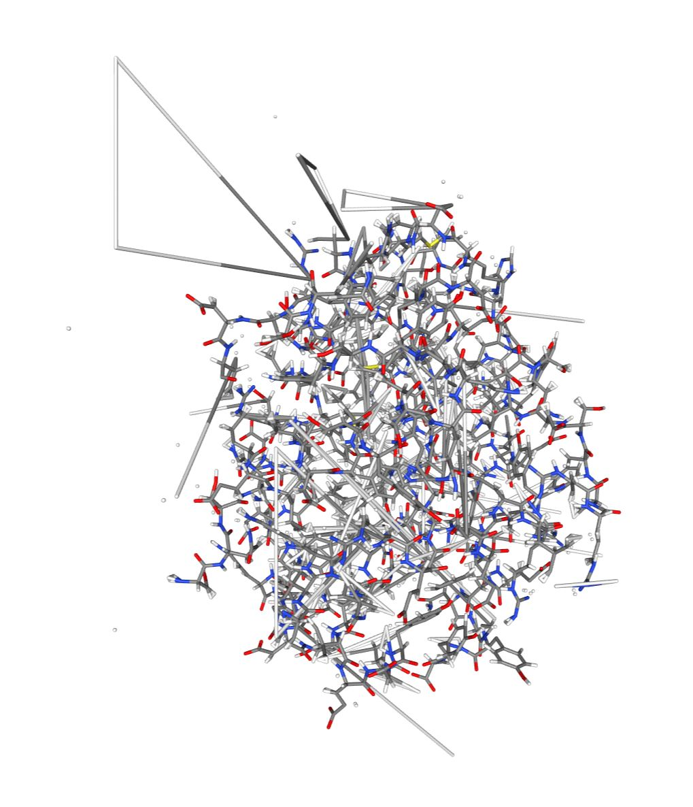
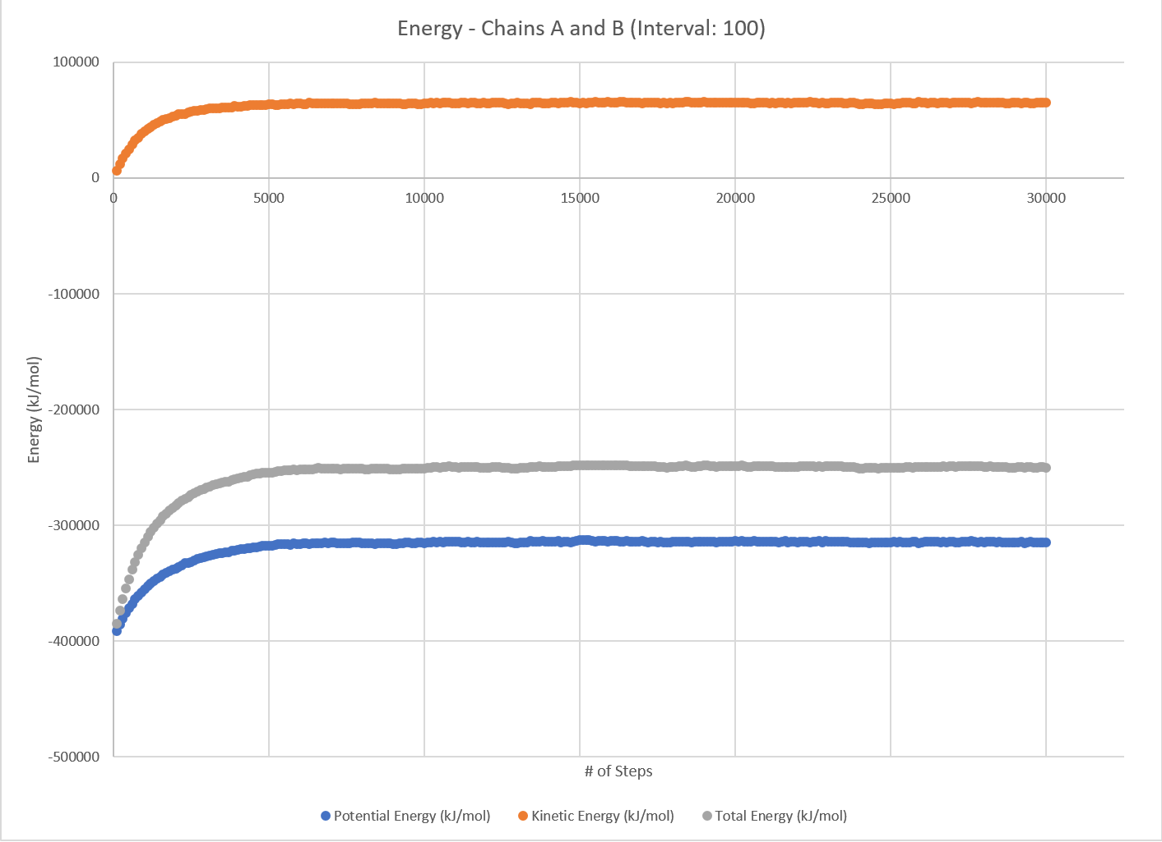
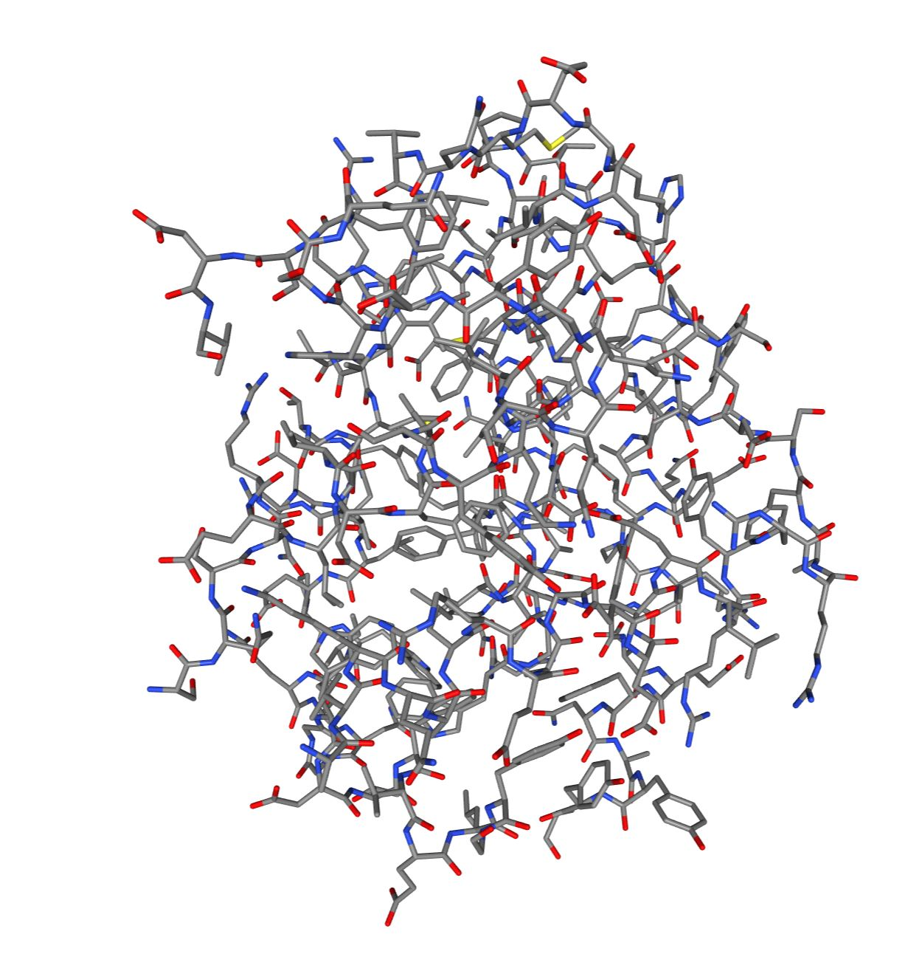
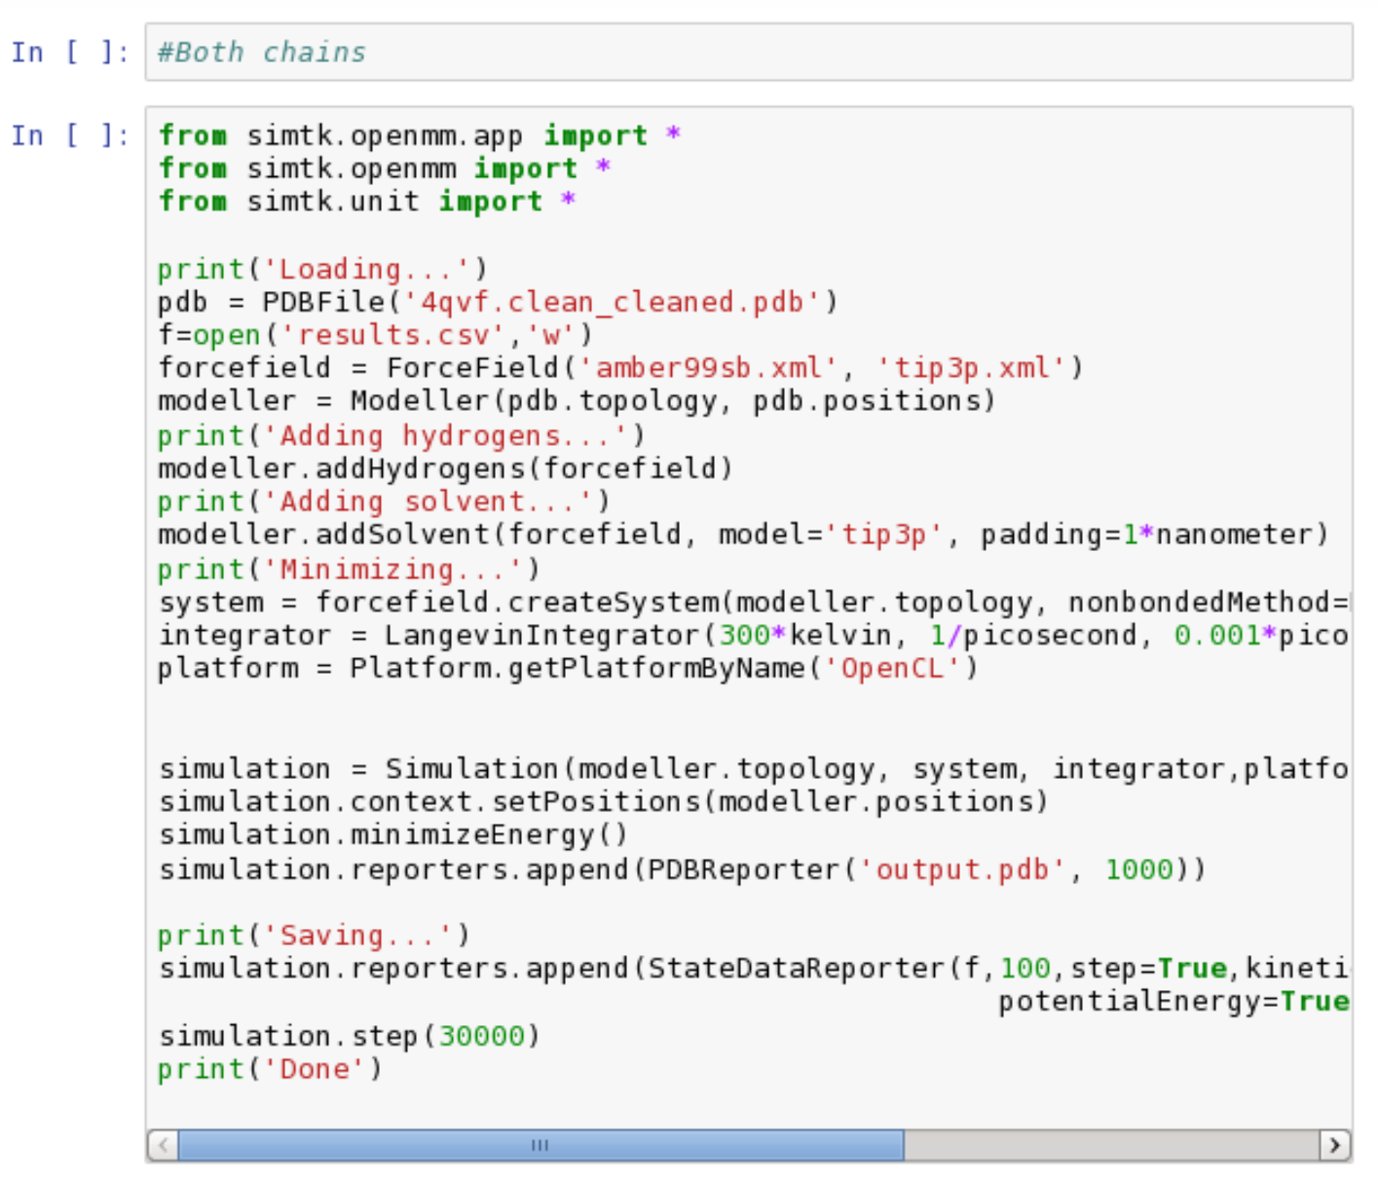
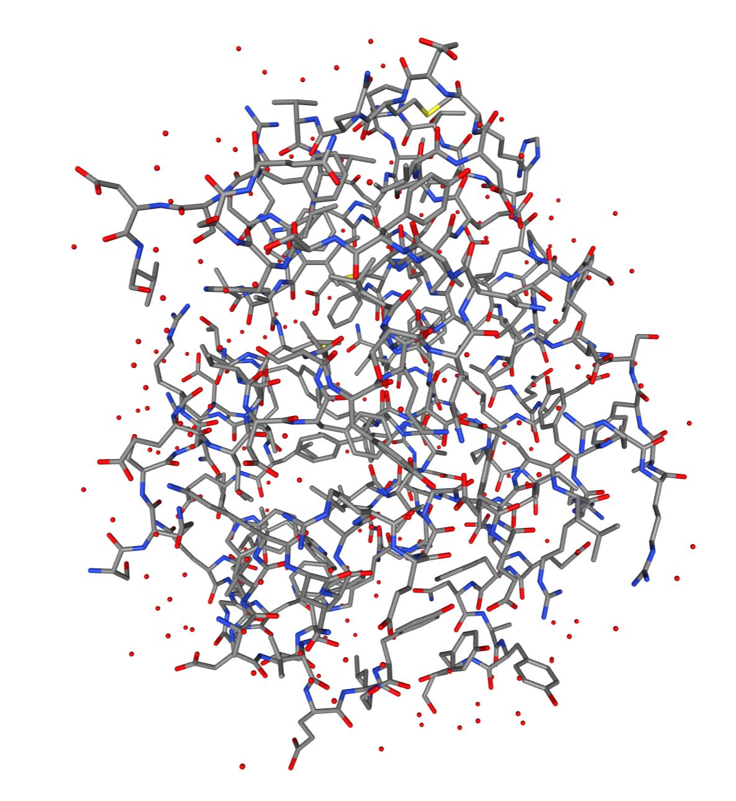
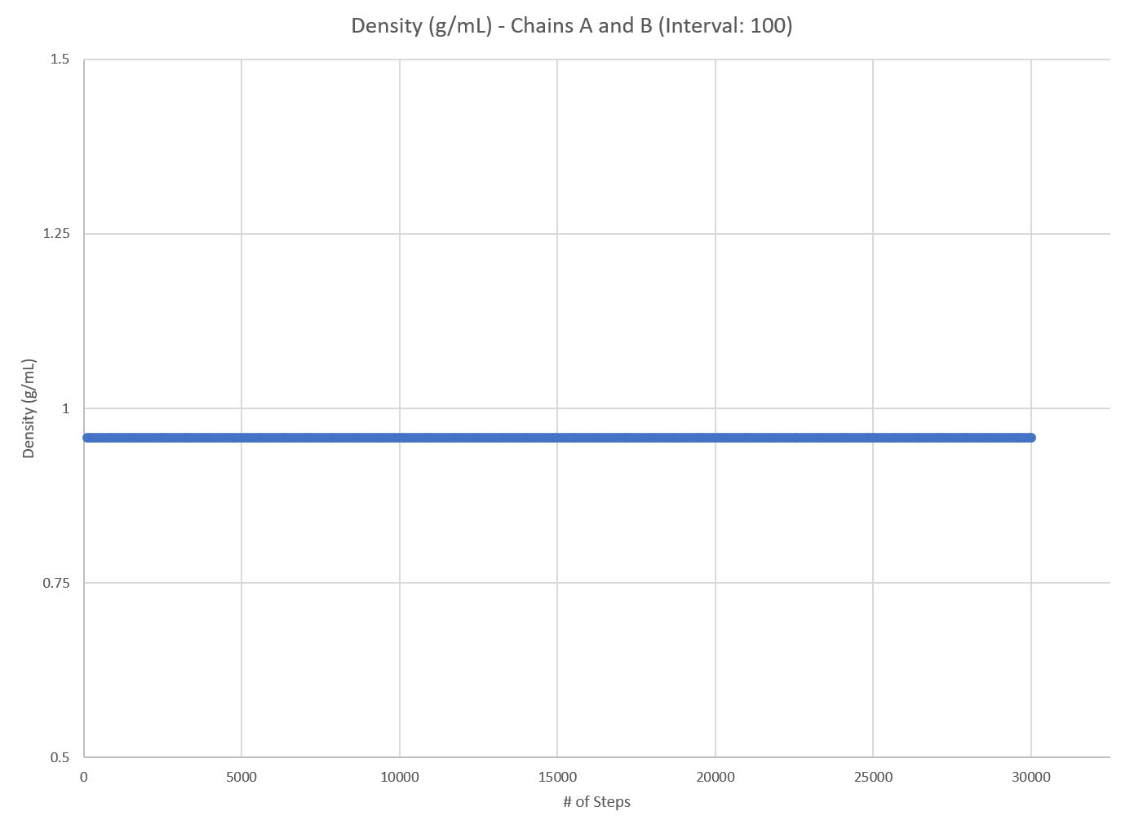
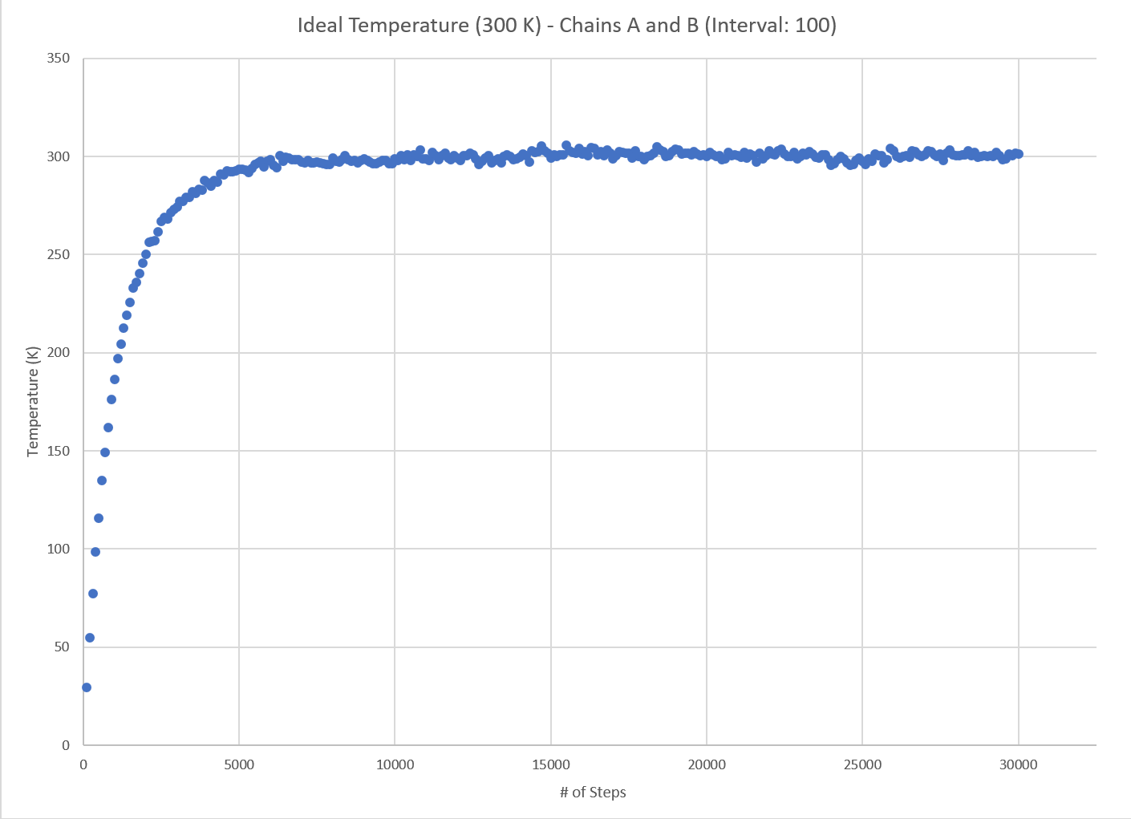
Results (A and B)
All energies reach equilibrium around step 6500
Estimated Equilibrium Total Energy for Chains A and B: -249613.87 kJ/mol

Slide 5
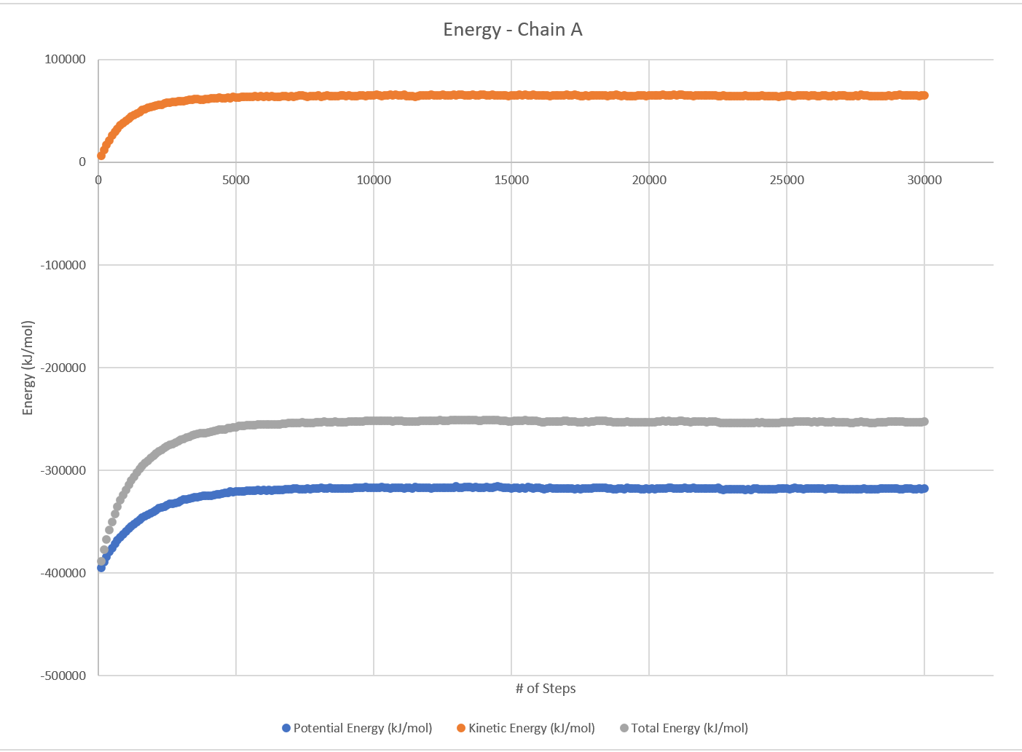
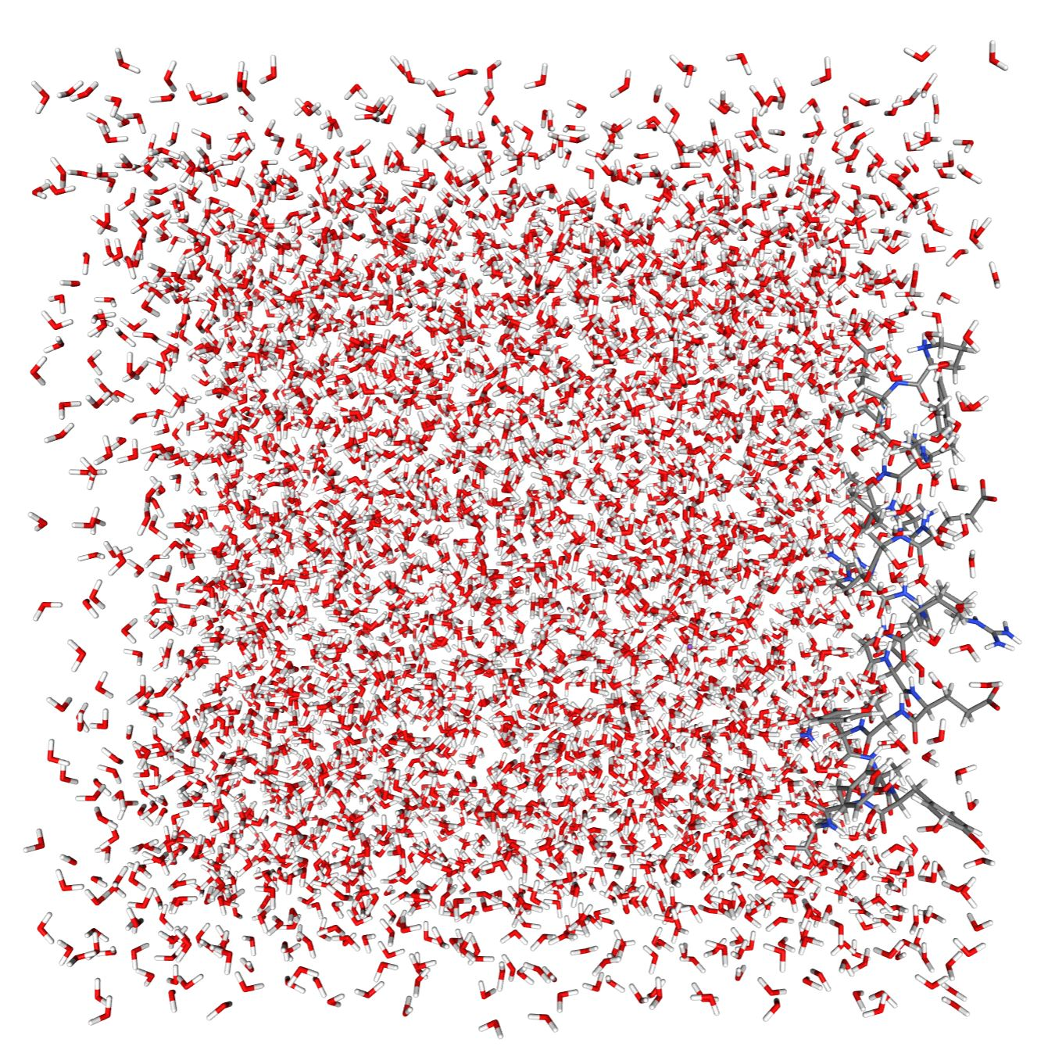
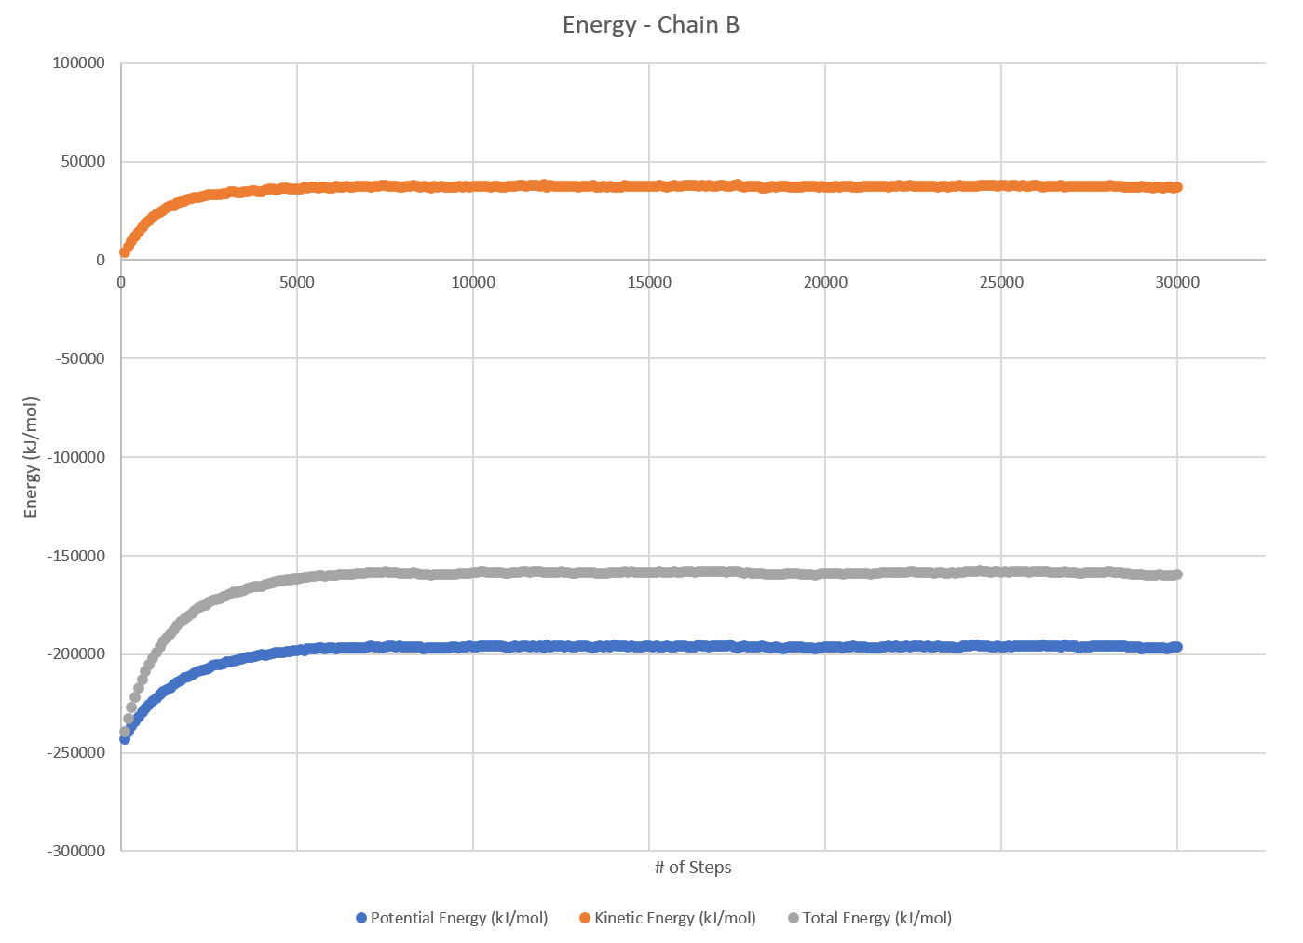
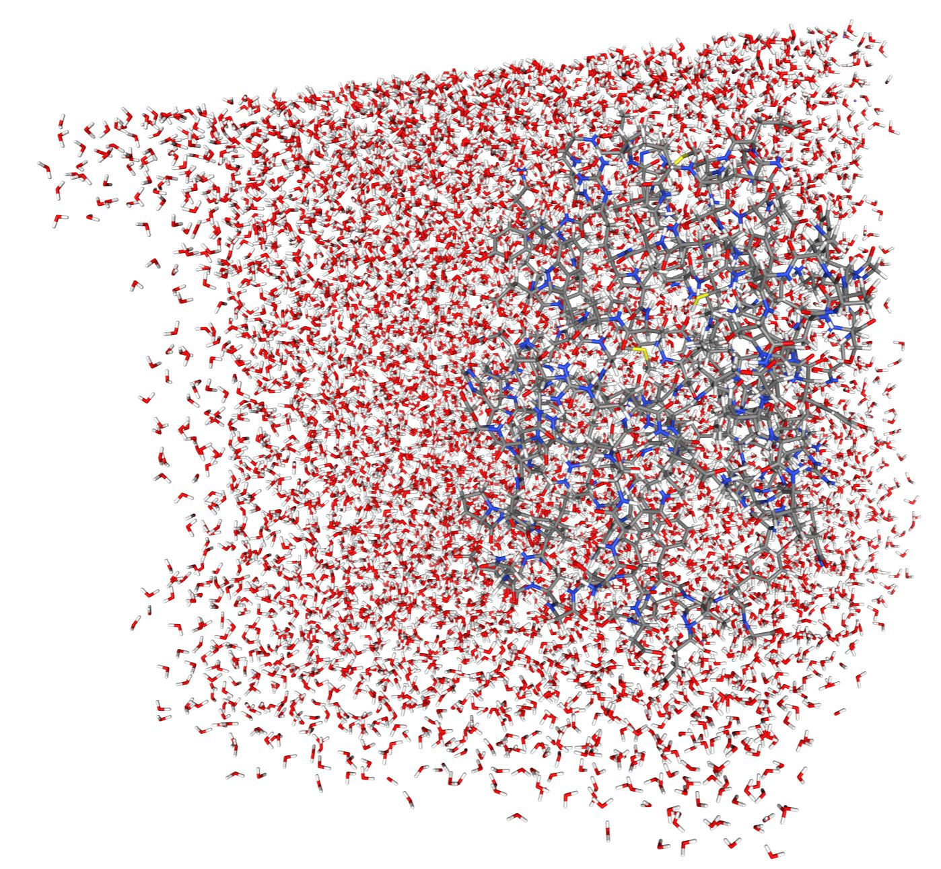
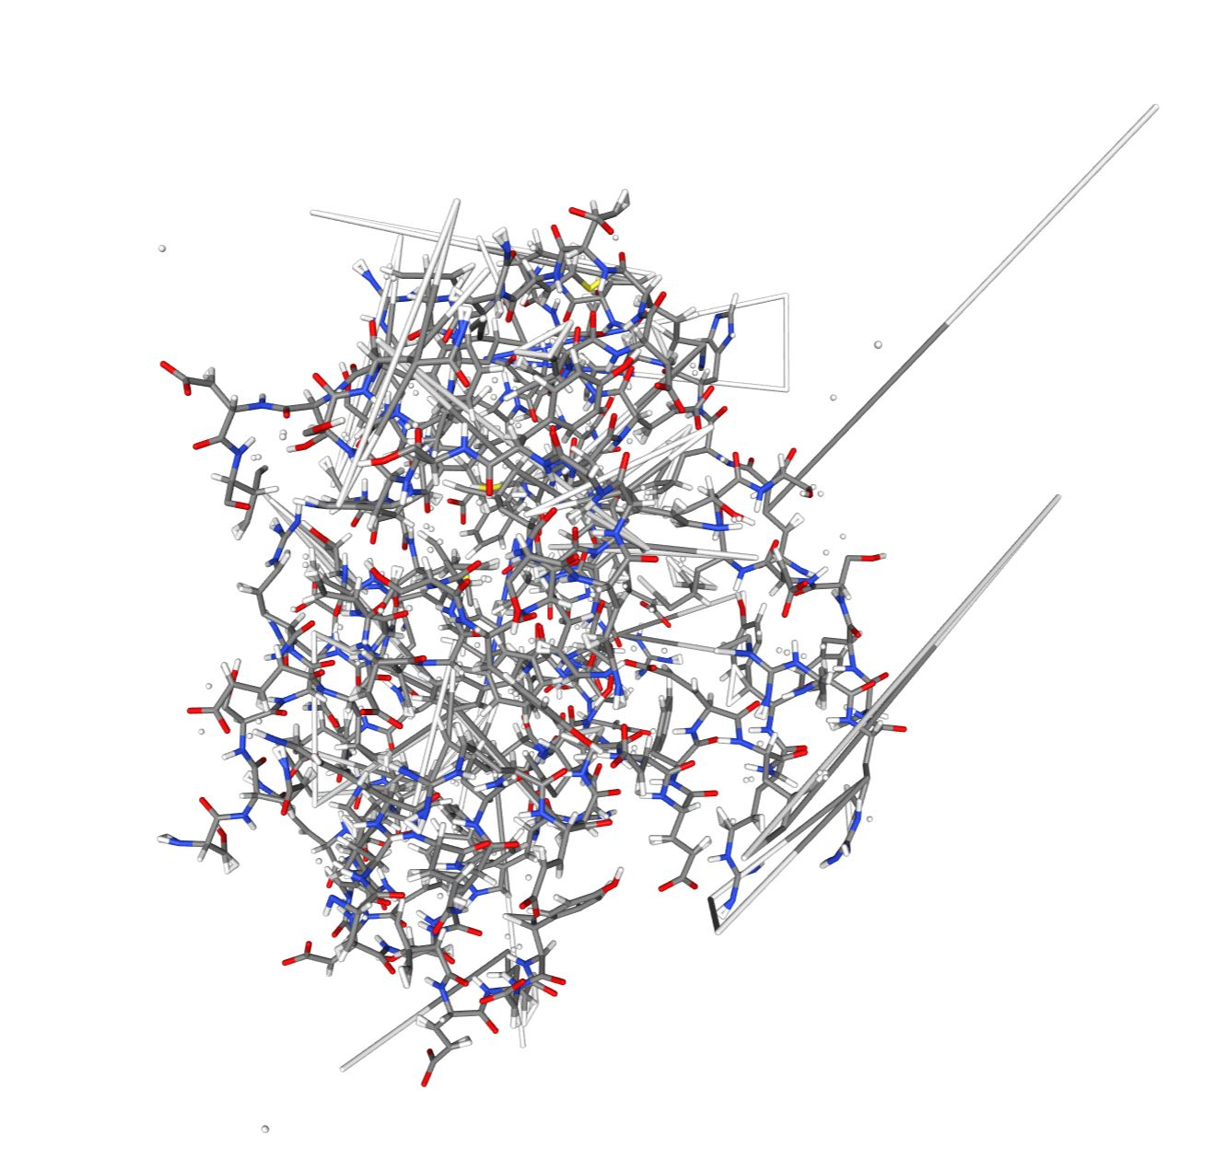
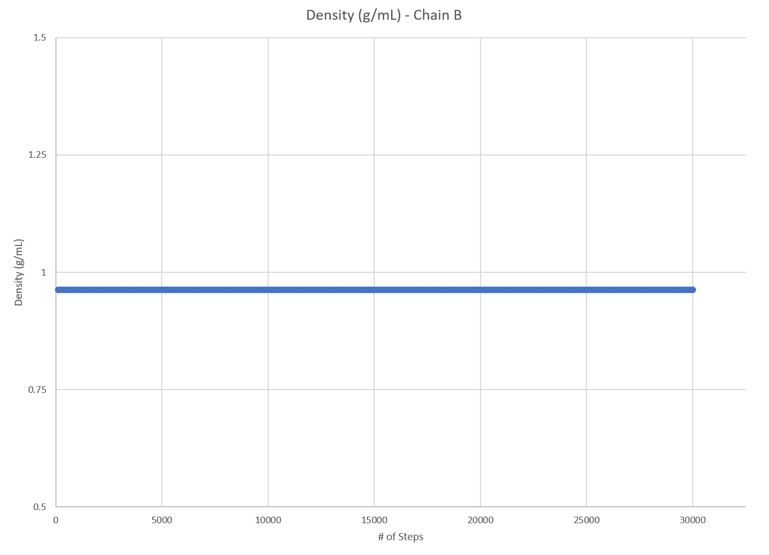
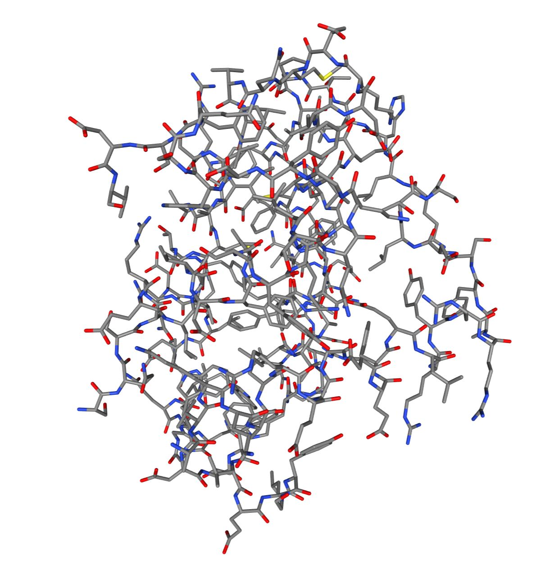
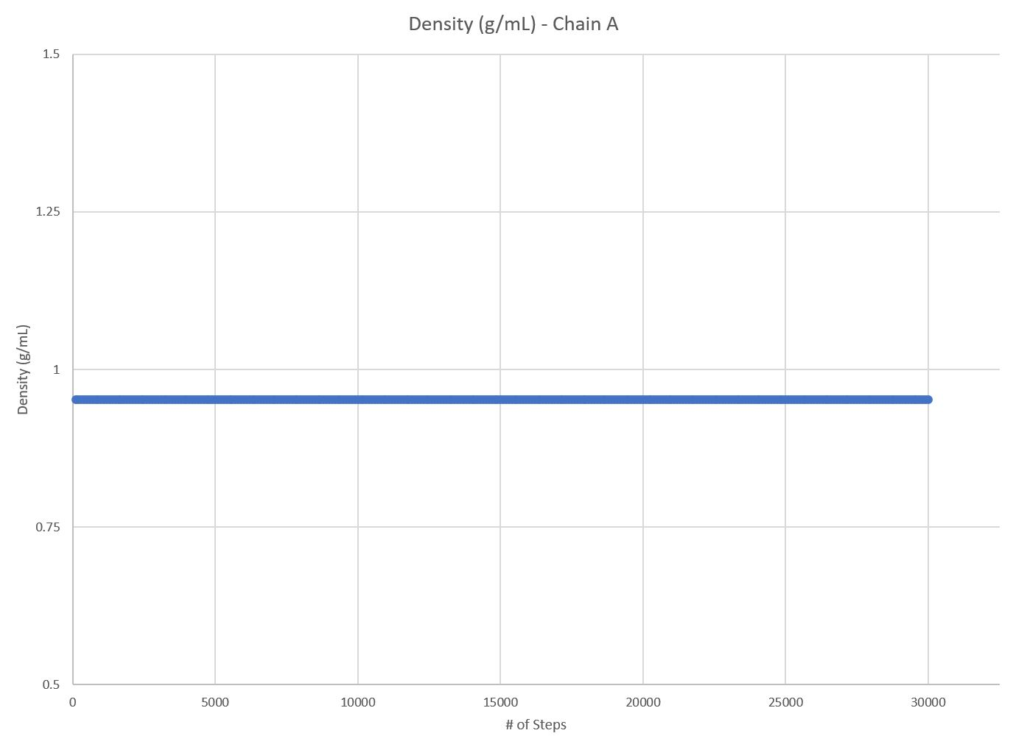
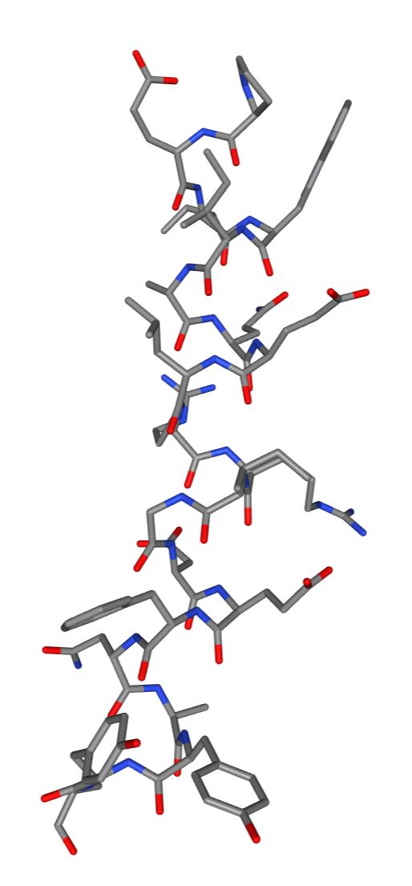
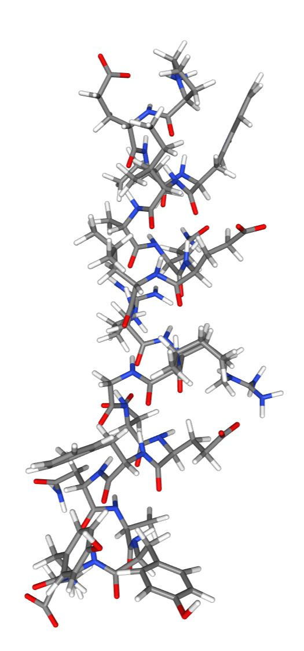
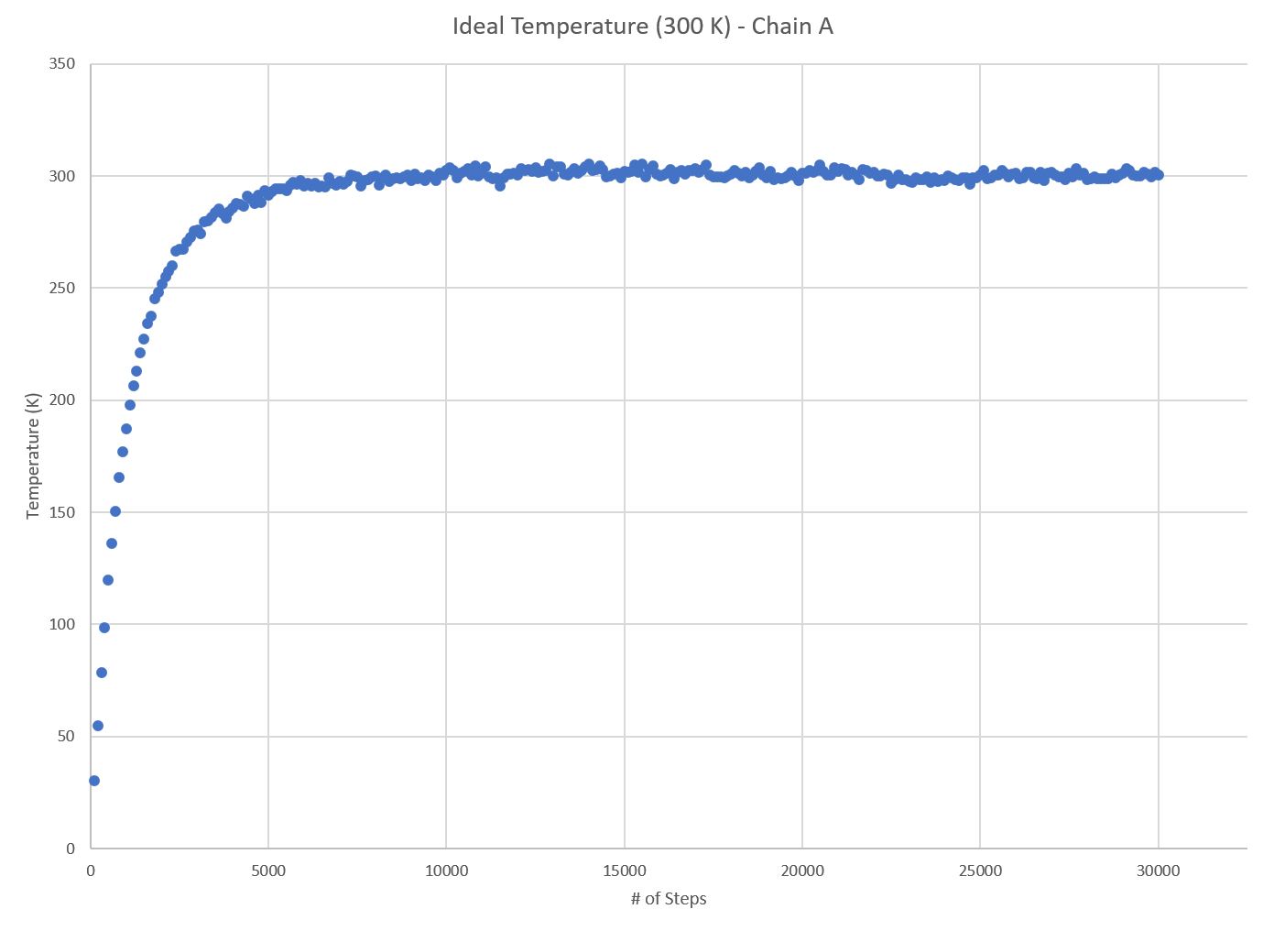
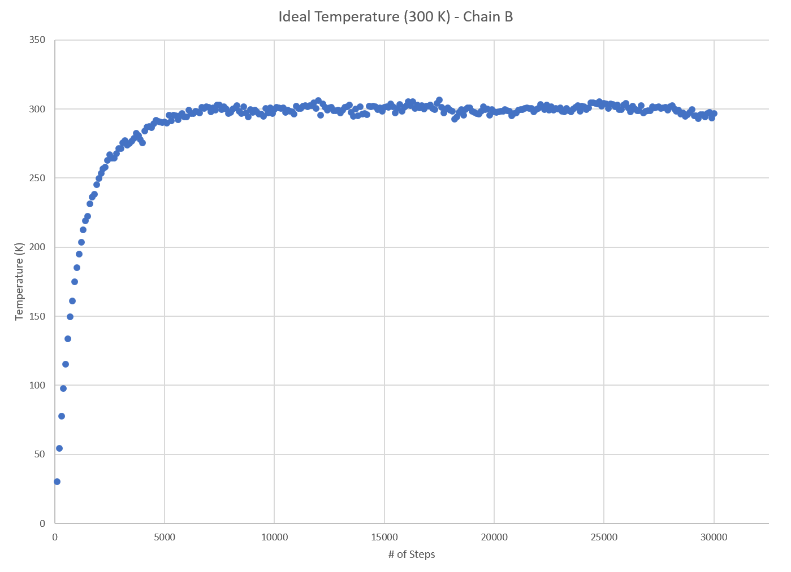
Chains and binding energy
Need to separate chains and run calculations and visualizations on each
Deleted other chain and saved into separate file
Chain A:
All energies reach equilibrium around step 6800
Estimated Equilibrium Total Energy for Chain A: -252546.27 kJ
Chain B:
All energies reach equilibrium around step 7000
Estimated Equilibrium Total Energy for Chain B: -158723.76 kJ
BE = Energy for (BCL-2) + Energy for (BIM-BH3) - Energy for complex (BCL-2-BIM-BH3)
-161656.16 = -252546.27 + -158723.76 - -249613.87
Binding Energy= -161656.16 kJ

Slide 6
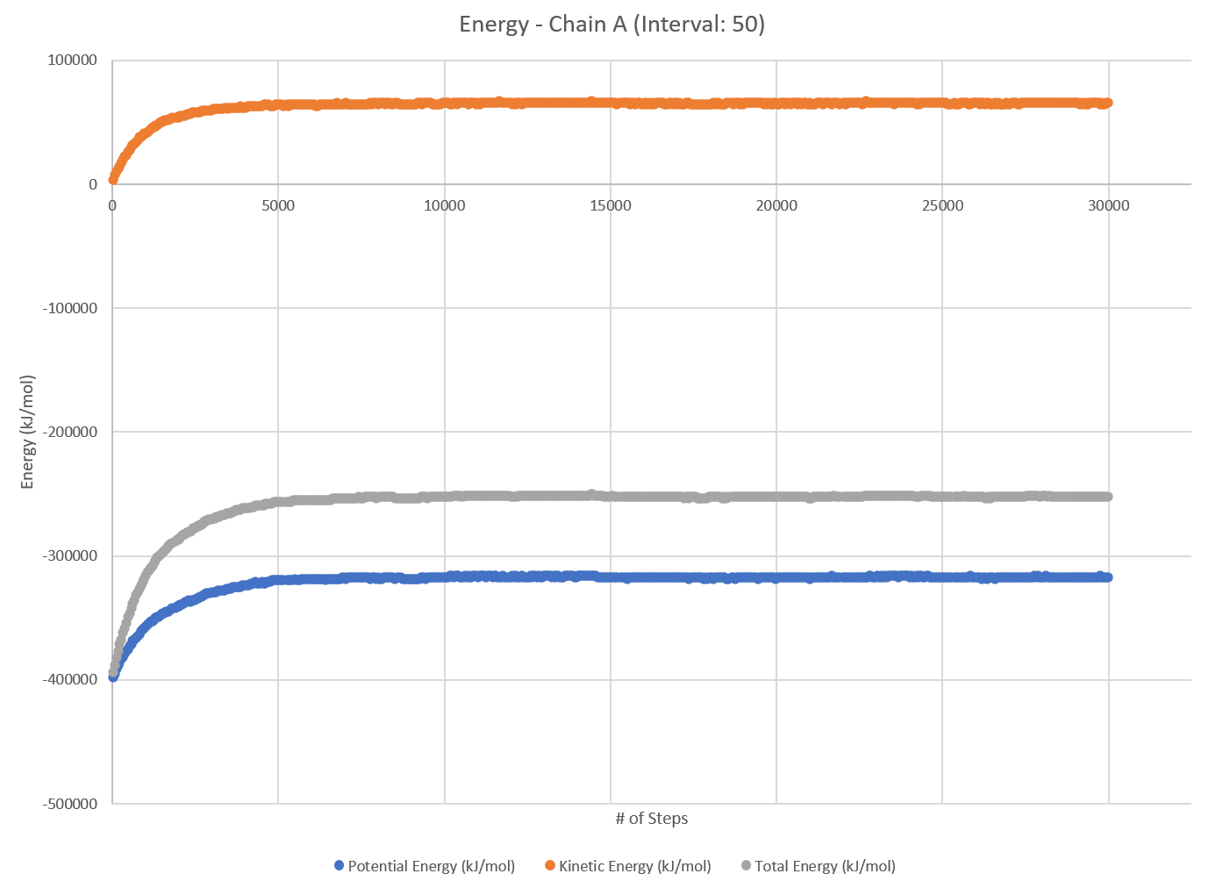
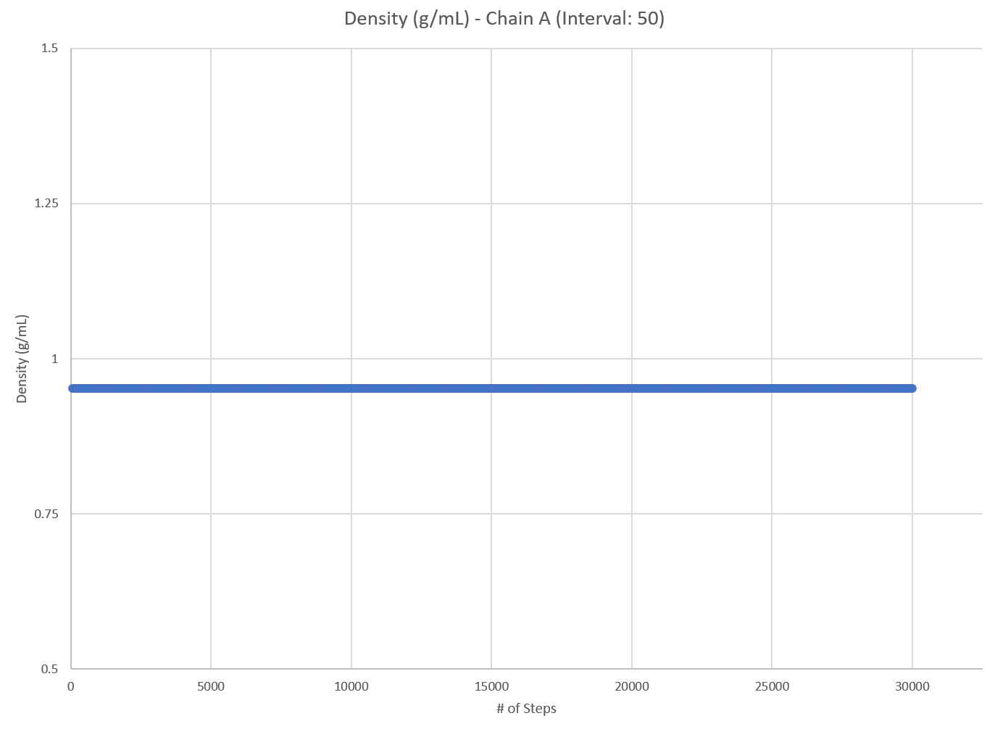
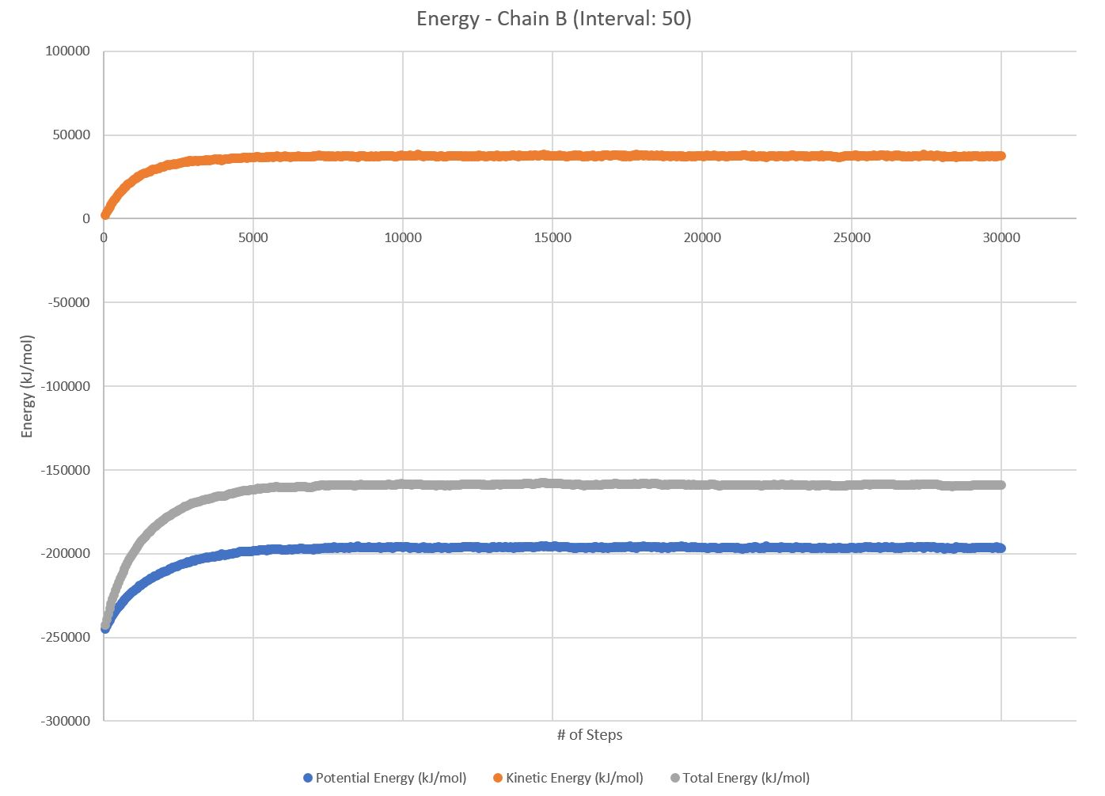
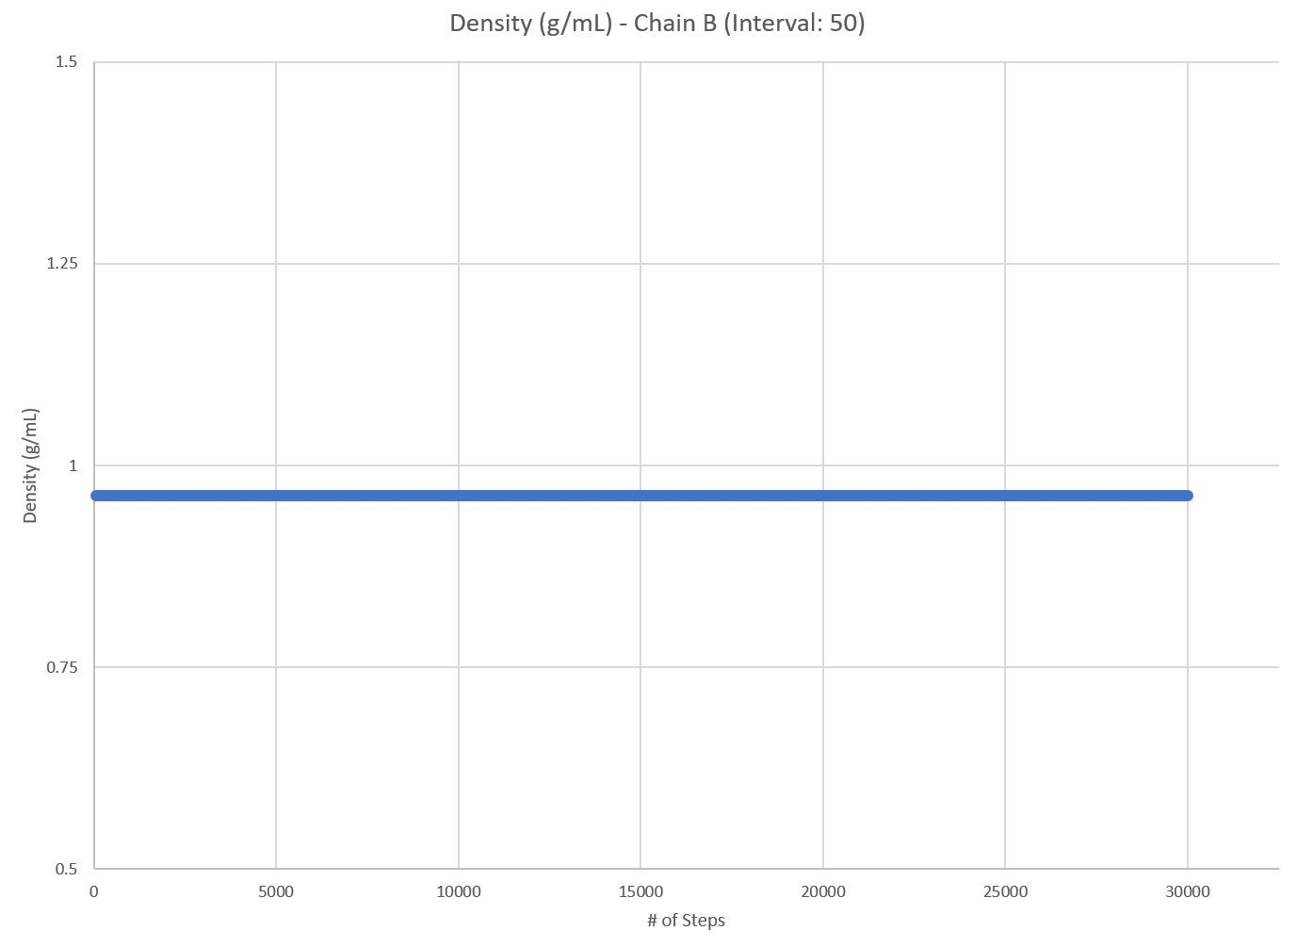
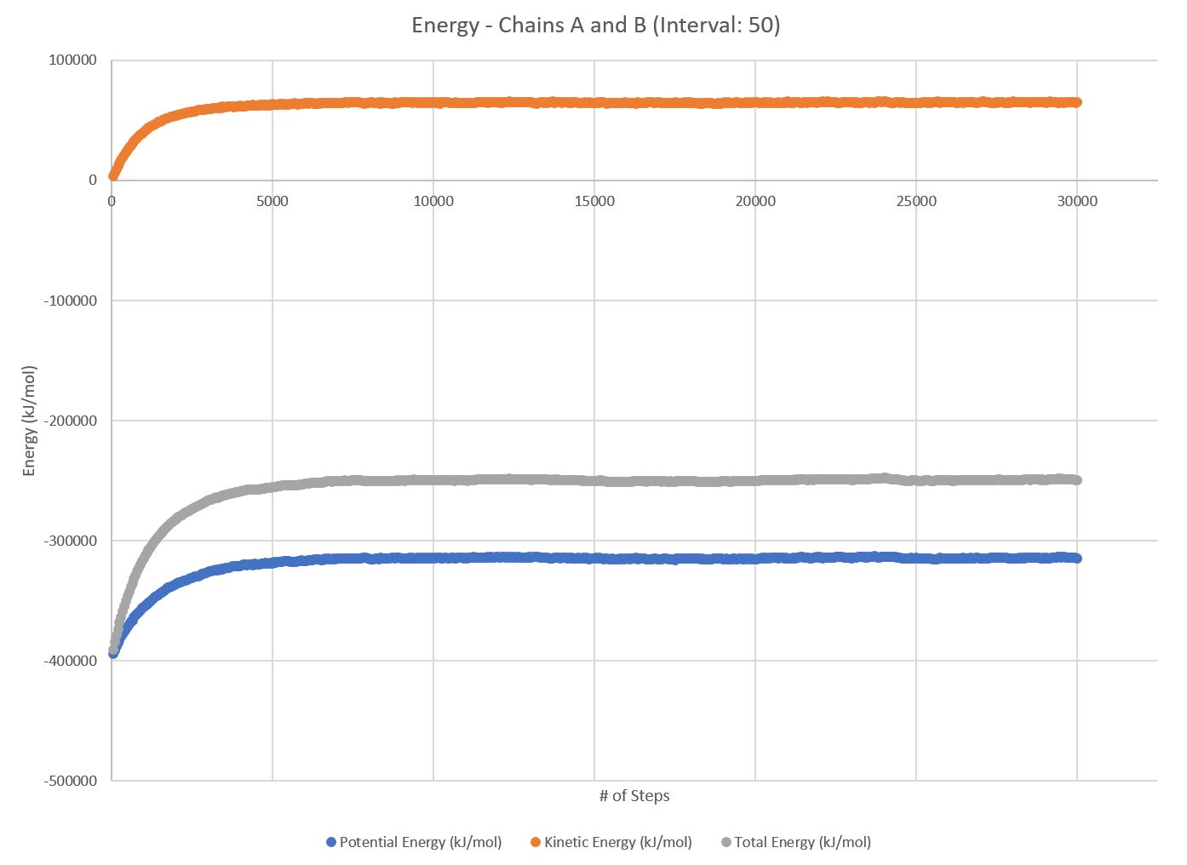

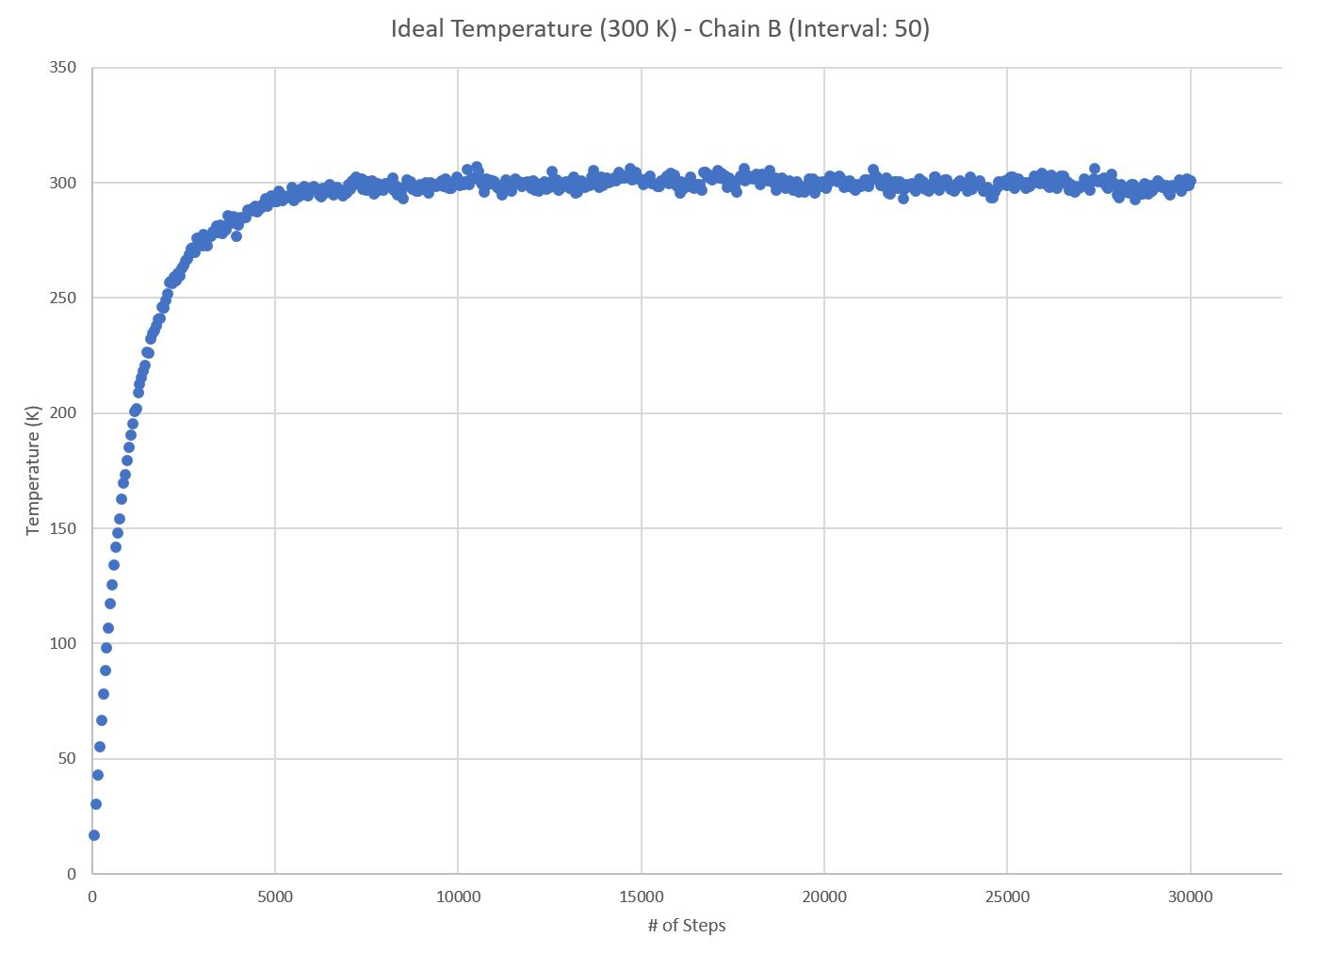
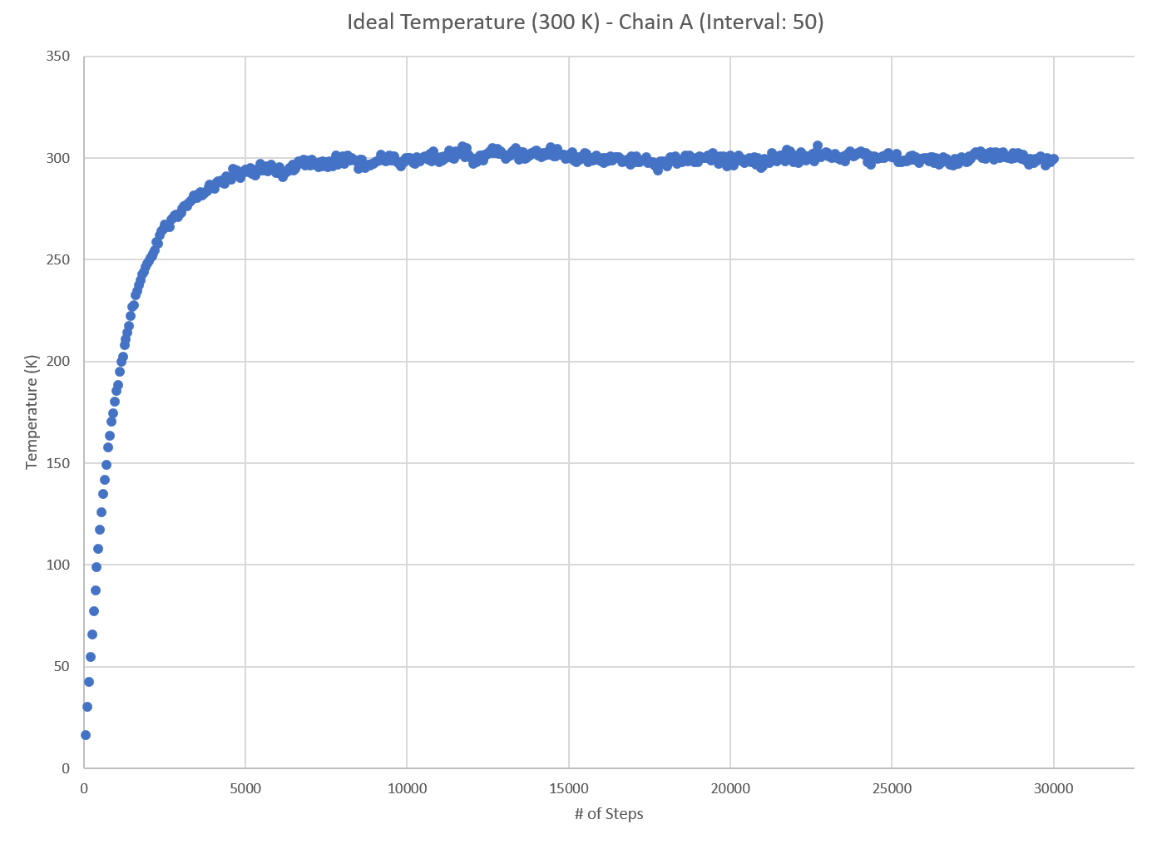
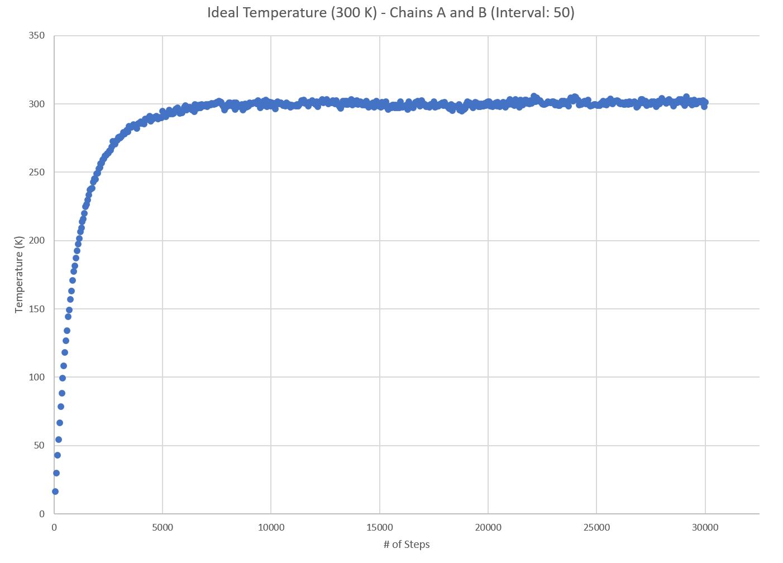
Test Case 1: Interval: 5
Chains A and B:
All energies reach equilibrium around step 7020
Estimated Equilibrium Total Energy for Chains A and B: -249609.40 kJ
Chain A:
All energies reach equilibrium around step 6450
Estimated Equilibrium Total Energy for Chain A: -252848.39 kJ
Chain B:
All energies reach equilibrium around step 7250
Estimated Equilibrium Total Energy for Chain B: -158836.60 kJ
BE = Energy for (BCL-2) + Energy for (BIM-BH3) - Energy for complex (BCL-2-BIM-BH3)
-162075.58 = -252848.39 + -158836.60 - -249609.40
Binding Energy= -162075.58 kJ

Slide 7
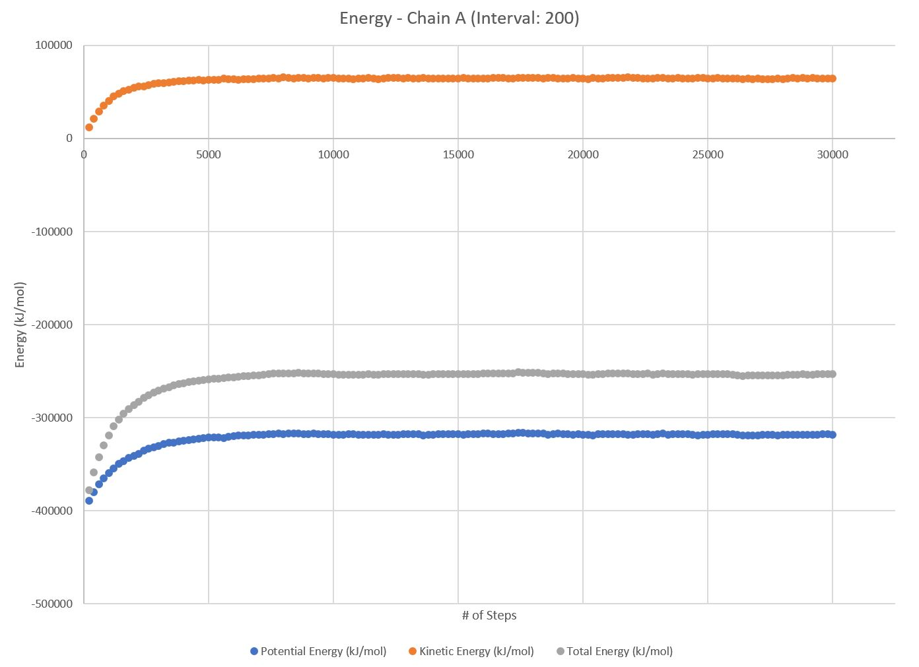
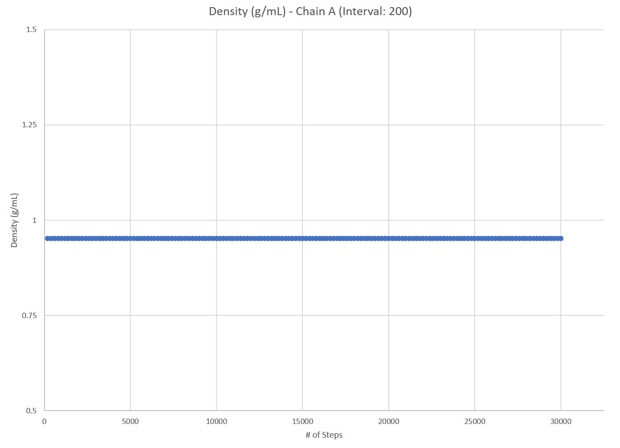
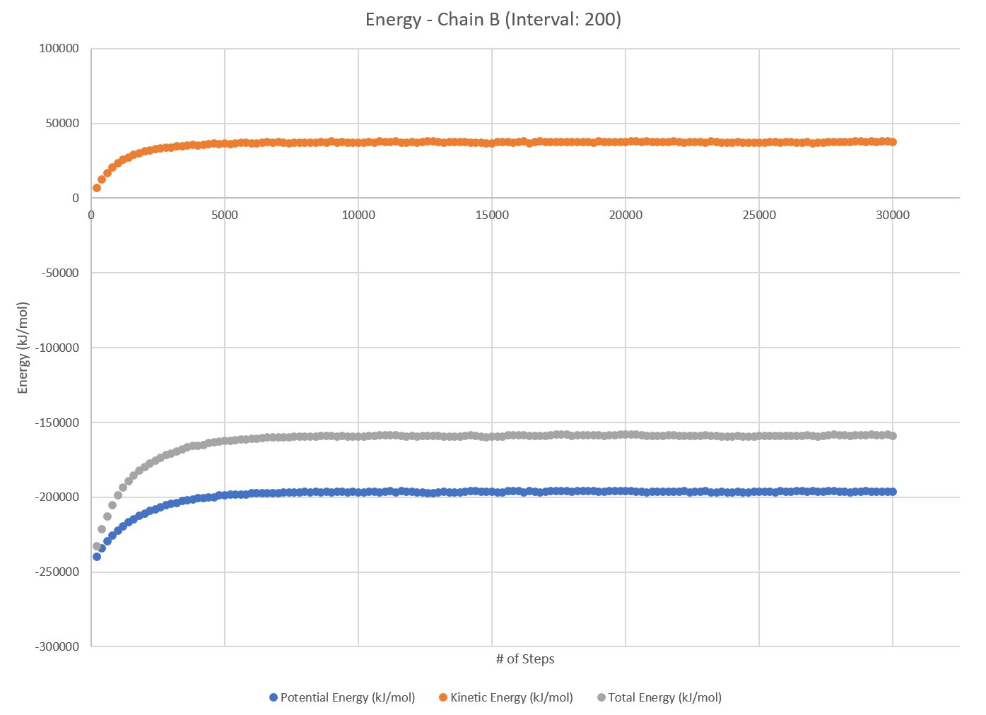

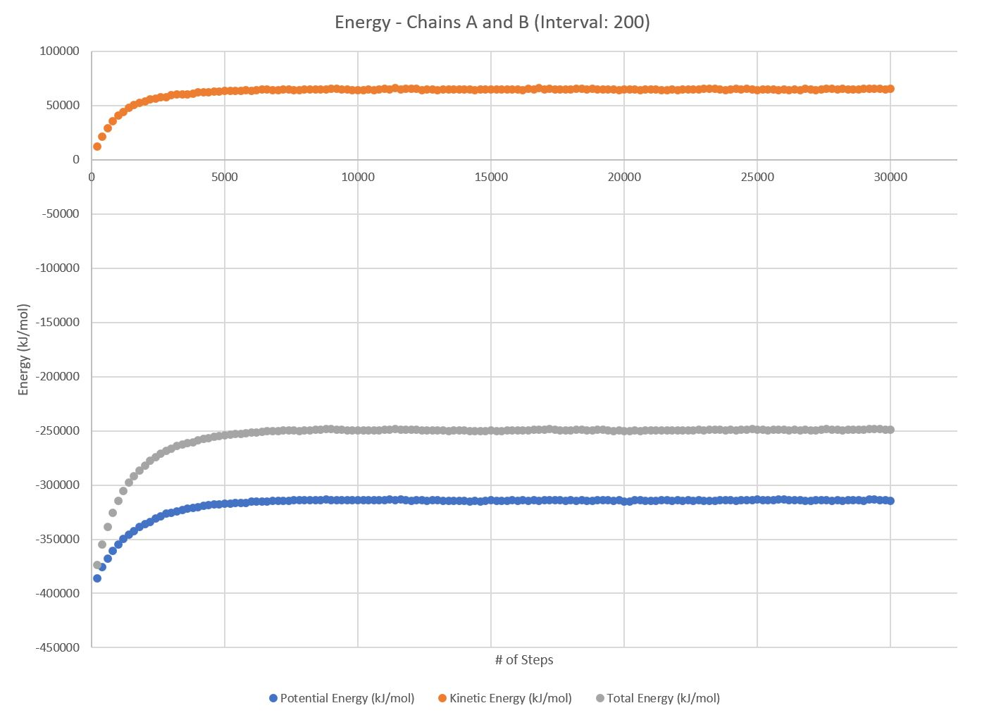
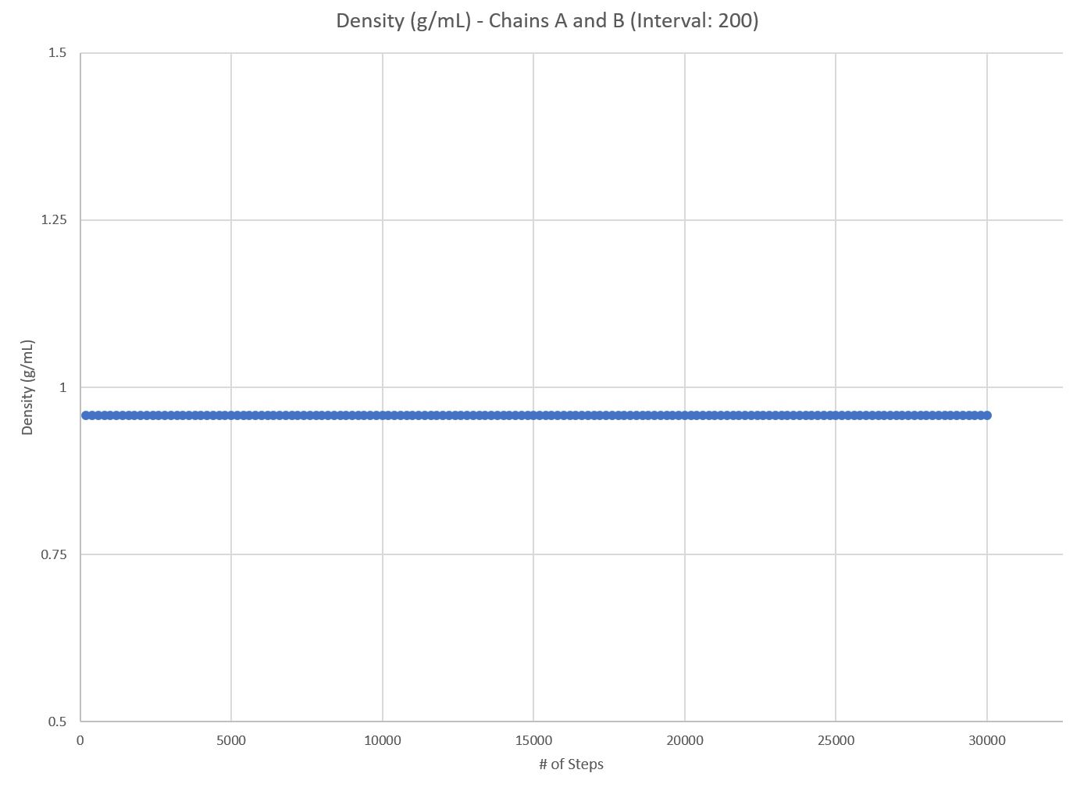
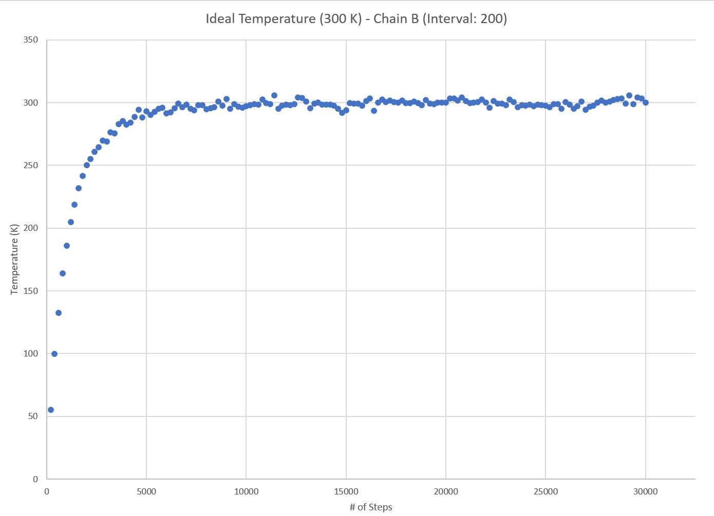
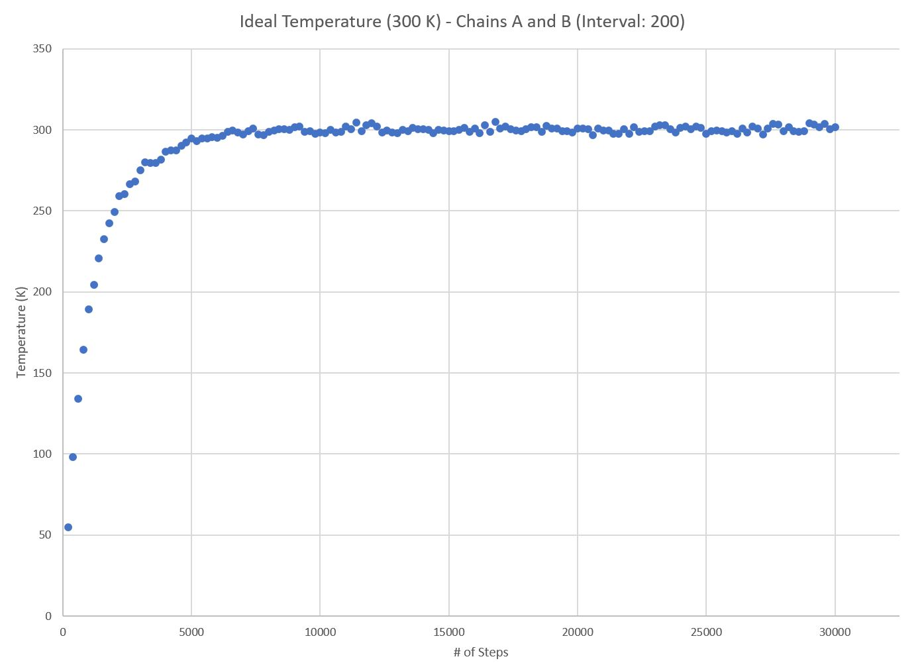
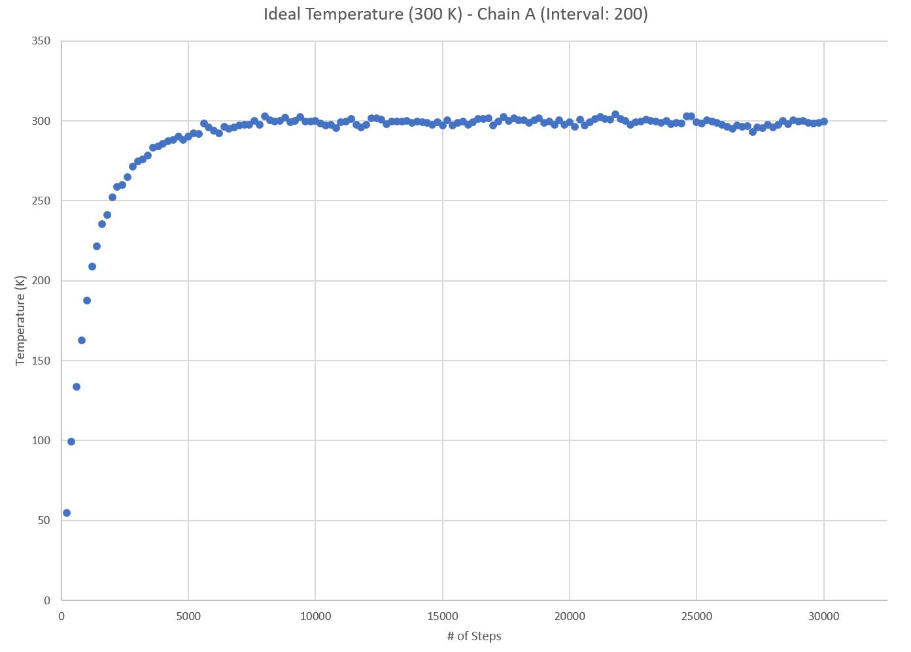
Test Case 2: Interval: 200
Chains A and B:
All energies reach equilibrium around step 7200
Estimated Equilibrium Total Energy for Chains A and B: -249374.33 kJ
Chain A:
All energies reach equilibrium around step 7800
Estimated Equilibrium Total Energy for Chain A: -253134.53 kJ
Chain B:
All energies reach equilibrium around step 7200
Estimated Equilibrium Total Energy for Chain B: -158941.52 kJ
BE = Energy for (BCL-2) + Energy for (BIM-BH3) - Energy for complex (BCL-2-BIM-BH3)
-162701.72 = -253134.53 + -158941.52 - -249374.33
Binding Energy= -162701.72 kJ

Slide 8
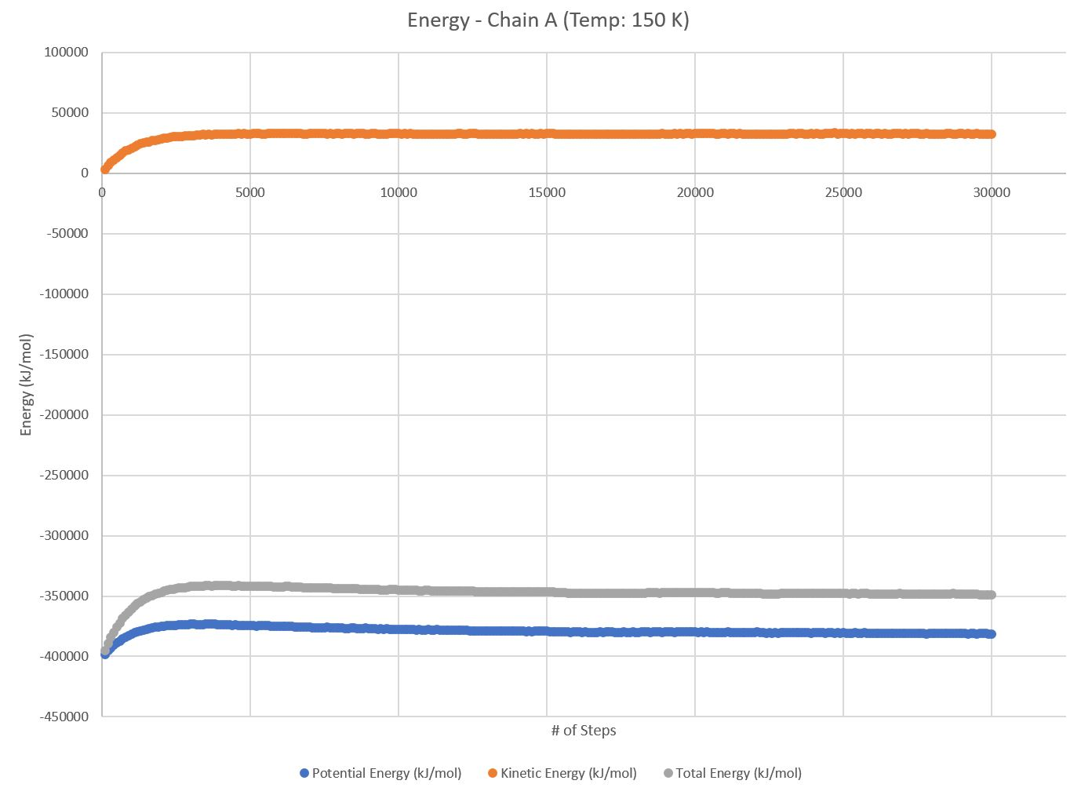

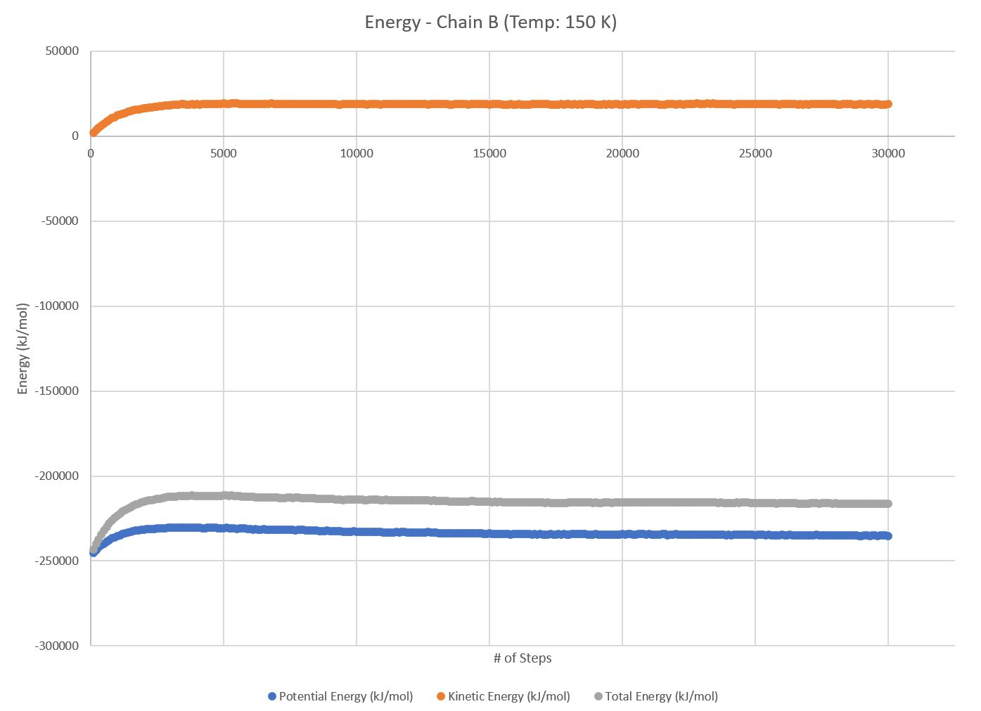

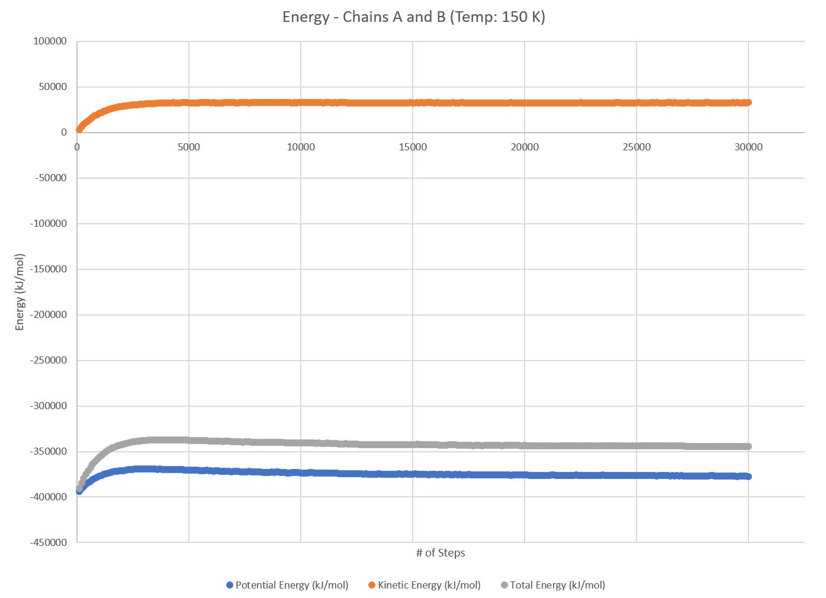
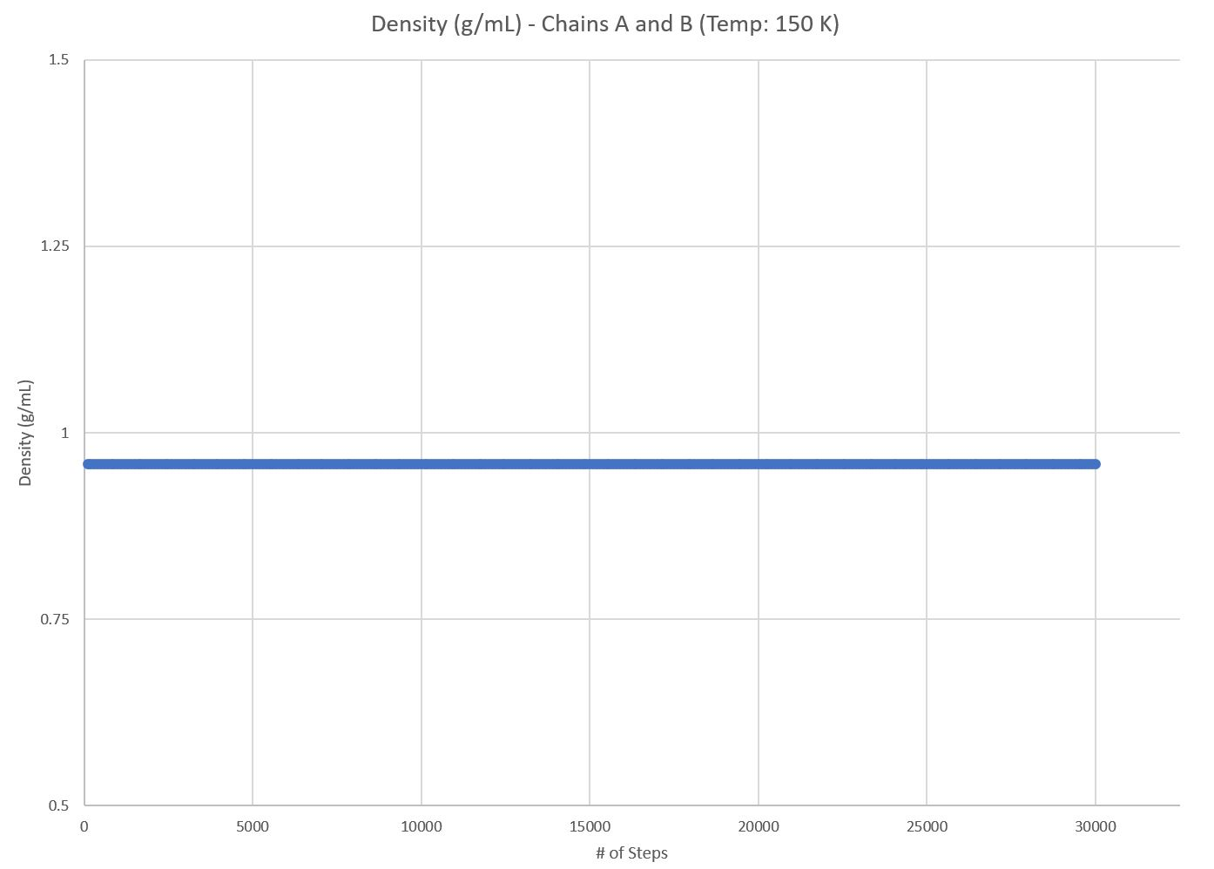
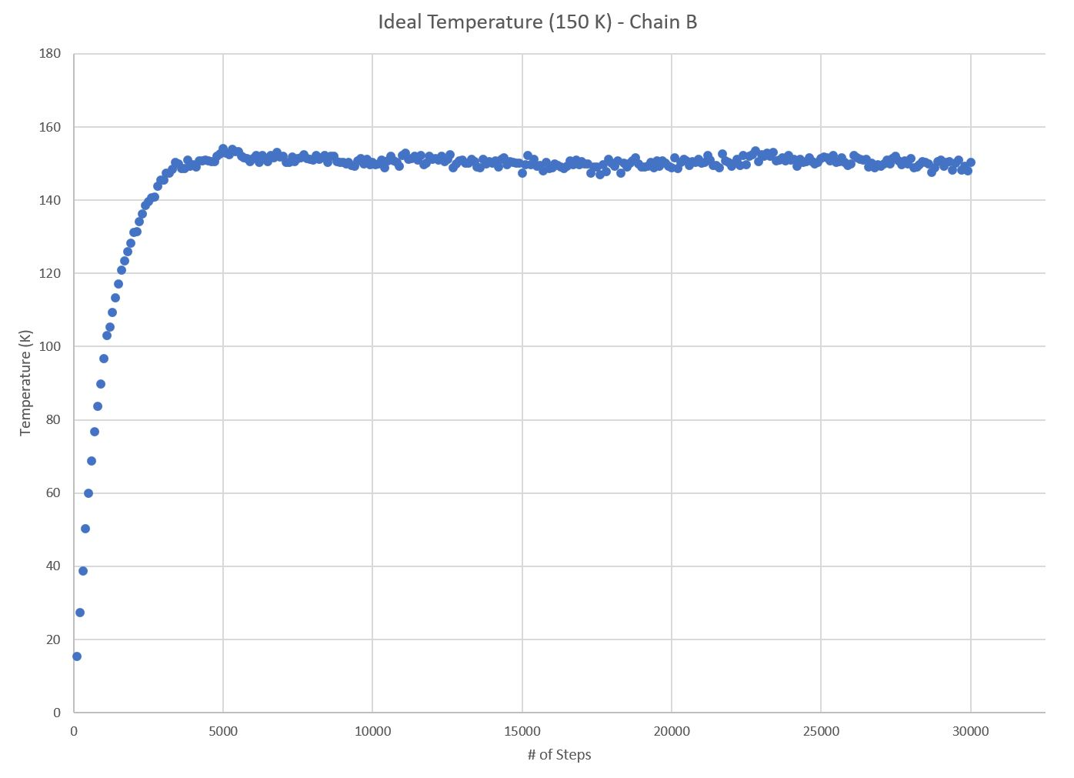
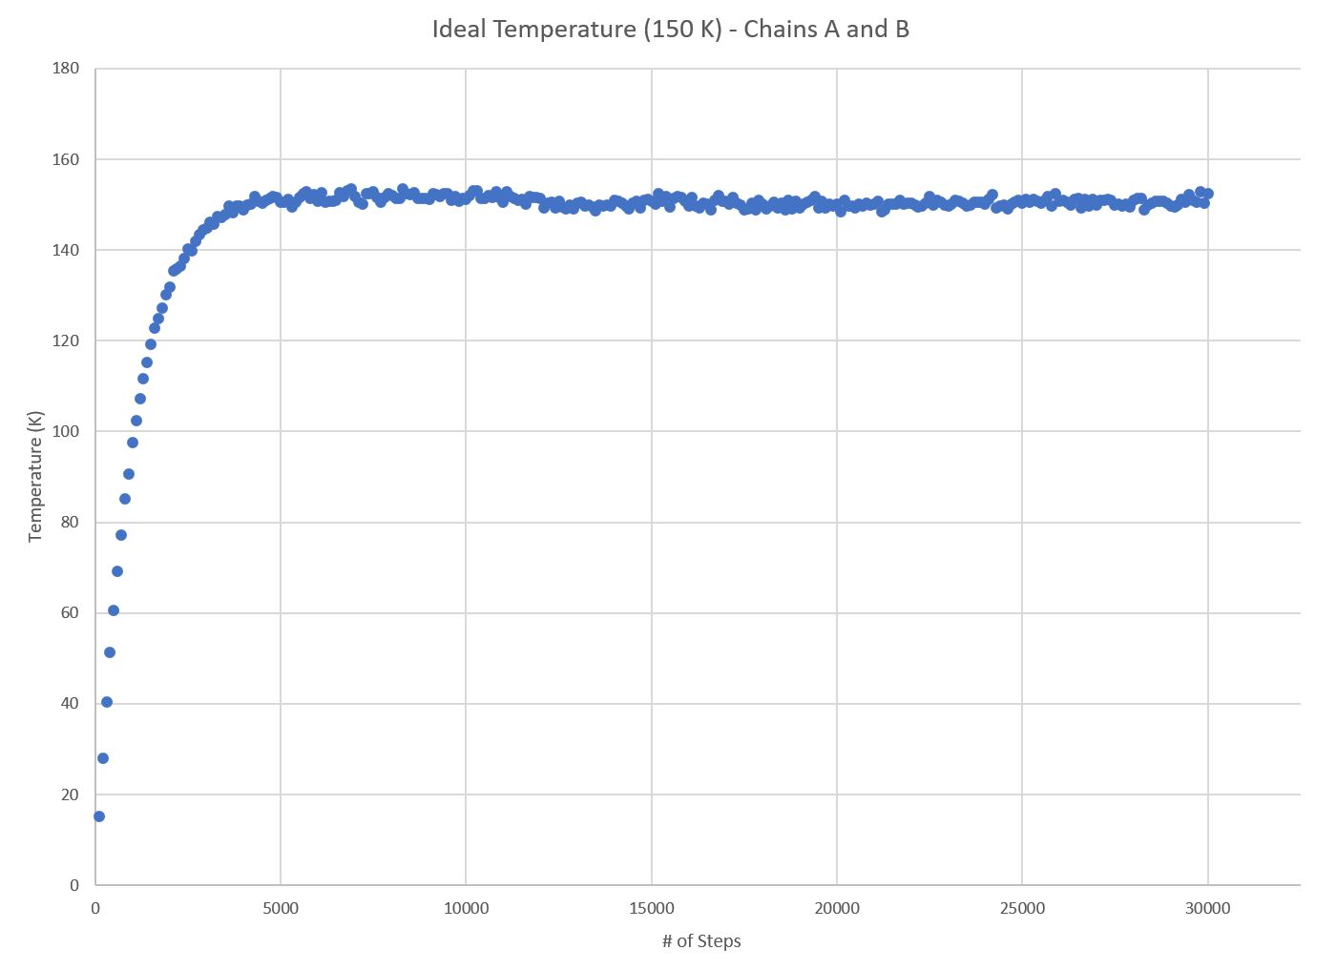
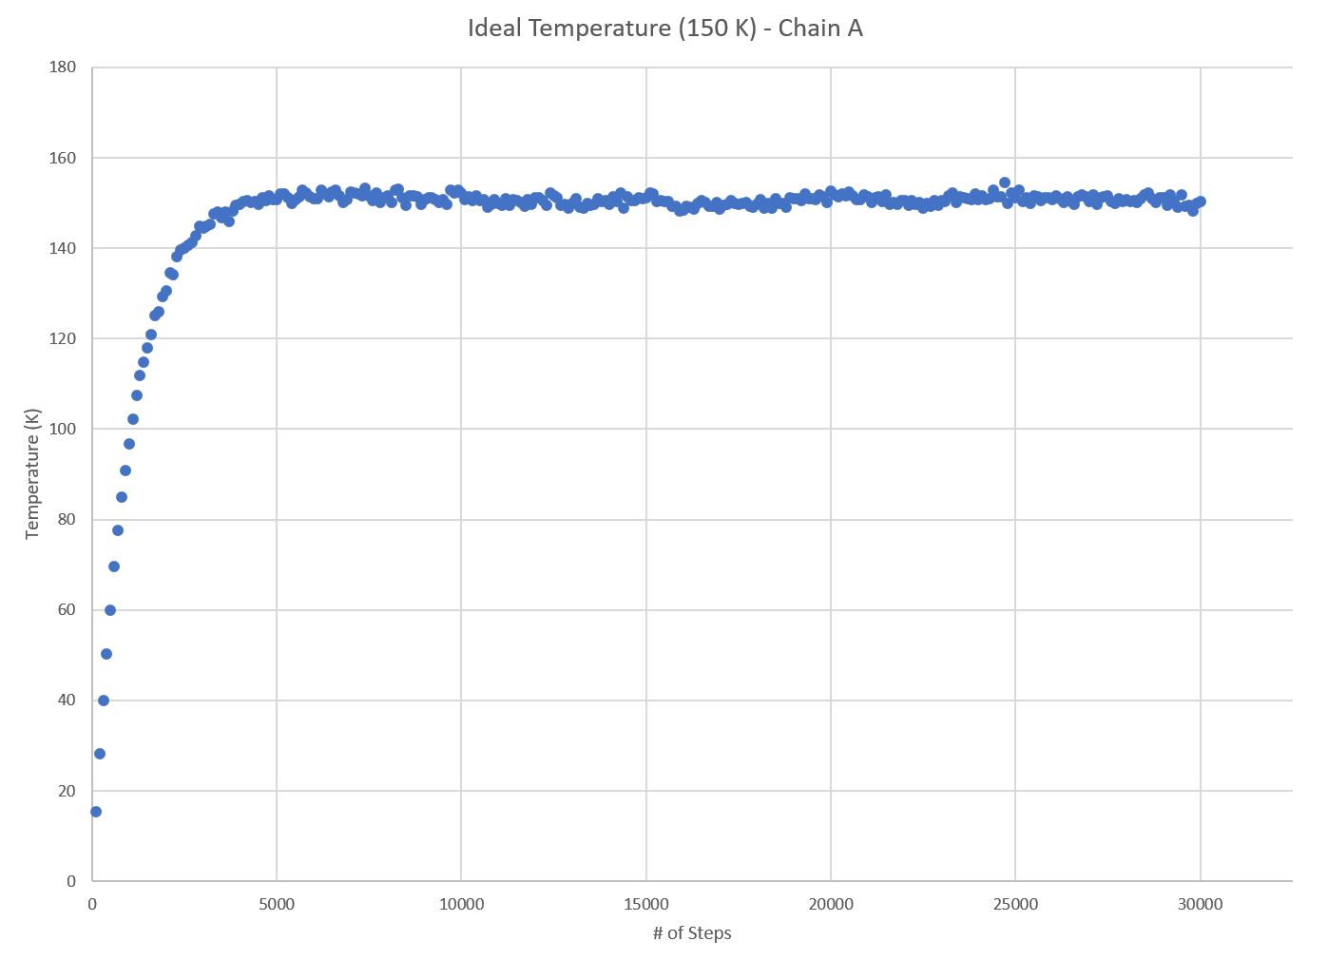
Test Case 3: TEMP: 150 K
Chains A and B:
All energies reach equilibrium around step 12800
Estimated Equilibrium Total Energy for Chains A and B: -343534.65 kJ
Chain A:
All energies reach equilibrium around step 6800
Estimated Equilibrium Total Energy for Chain A: -347699.50 kJ
Chain B:
All energies reach equilibrium around step 17700
Estimated Equilibrium Total Energy for Chain B: -215821.59 kJ
BE = Energy for (BCL-2) + Energy for (BIM-BH3) - Energy for complex (BCL-2-BIM-BH3)
-219986.44 = -347699.50 + -215821.59 - -343534.65
Binding Energy= -219986.44 kJ

Slide 9
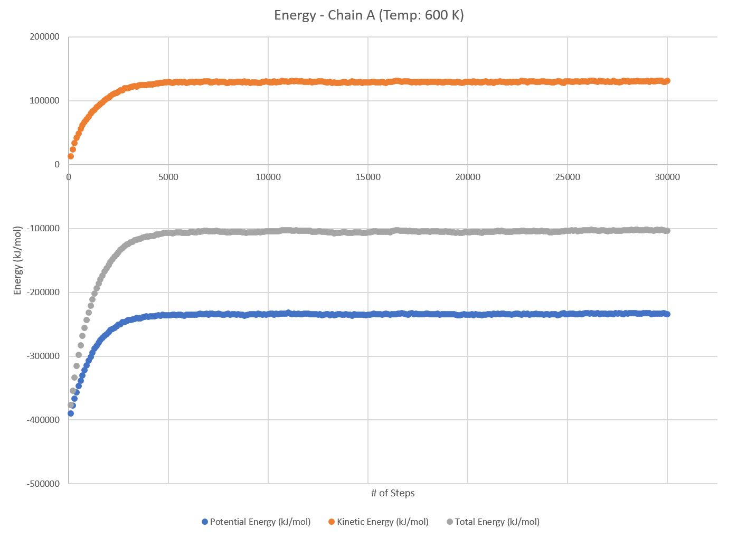

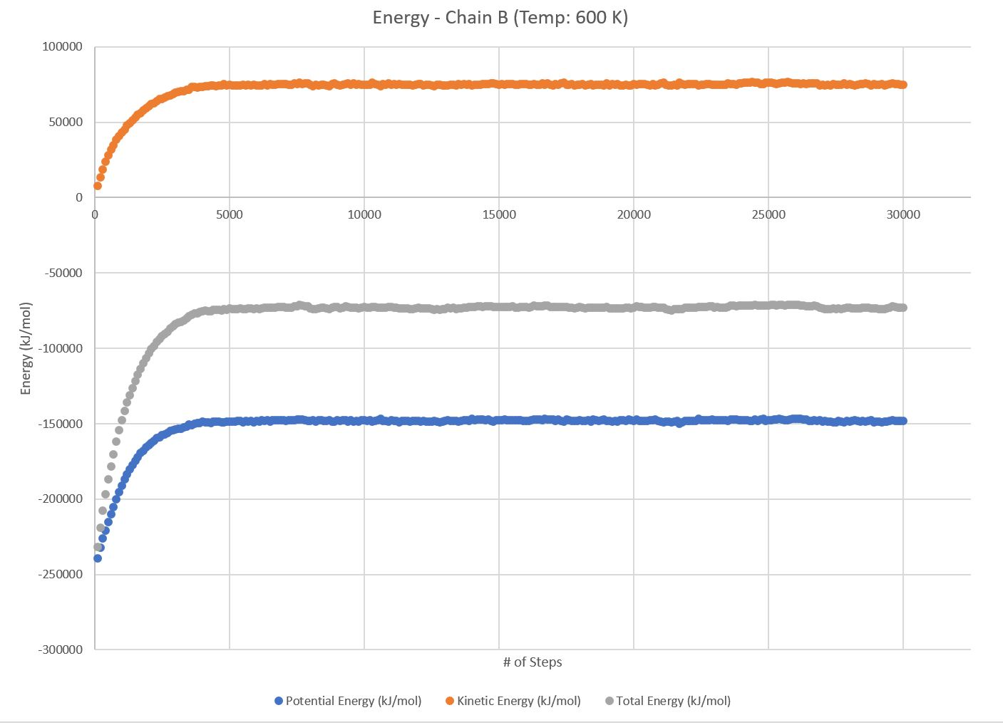






Test Case 4: TEMP: 600 K
Chains A and B:
All energies reach equilibrium around step 5500
Estimated Equilibrium Total Energy for Chains A and B: -102023.20 kJ
Chain A:
All energies reach equilibrium around step 5800
Estimated Equilibrium Total Energy for Chain A: -104639.49 kJ
Chain B:
All energies reach equilibrium around step 4600
Estimated Equilibrium Total Energy for Chain B: -72883.12 kJ
BE = Energy for (BCL-2) + Energy for (BIM-BH3) - Energy for complex (BCL-2-BIM-BH3)
-75499.41 = -104639.49 + -72883.12 - -102023.20
Binding Energy= -75499.41 kJ

Slide 10
REFERENCES
Chipuk, J E, et al. “Mitochondrial Outer Membrane Permeabilization during Apoptosis: the Innocent Bystander Scenario.” Nature, Nature Publishing Group, 19 May 2006, www.nature.com/cdd/journal/v13/n8/full/4401963a.html?foxtrotcallback=true.
Rajan, Sreekanth, et al. “Bh3 Induced Conformational Changes in Bcl‐Xl Revealed by Crystal Structure and Comparative Analysis.” Wiley Online Library, Proteins: Structure, Function, and Bioinformatics, 23 May 2015, onlinelibrary.wiley.com/doi/10.1002/prot.24816/epdf?referrer_access_token=HDqstRRuisjo_yk2dKN MpE4keas67K9QMdWULTWMo8Mv2et5Yz-Tv2pP76vo2ZmVT3KqeaXvND-UqiK-dPIoAt0OBkYVmhIf9ze wmHZLptB53XEbya-6d1reGR47m6OBt_5dmURDwFt0HVLWRsQD3fsZtvOt3rKtkhBDzz3Gy3f5q5hdlmUF cQNLmXYjQK4L8iyda8ts8hWyCm5_RqiTHAE8-00TH6JRt-cTisRSaM%3D.
Rajan, Sreekanth, et al. “Bh3 Induced Conformational Changes in Bcl-Xl Revealed by Crystal Structure and Comparative Analysis.” Proteins, RCSB, 10 June 2015, www.rcsb.org/pdb/explore.do?structureId=4QVF.

